Slide 1
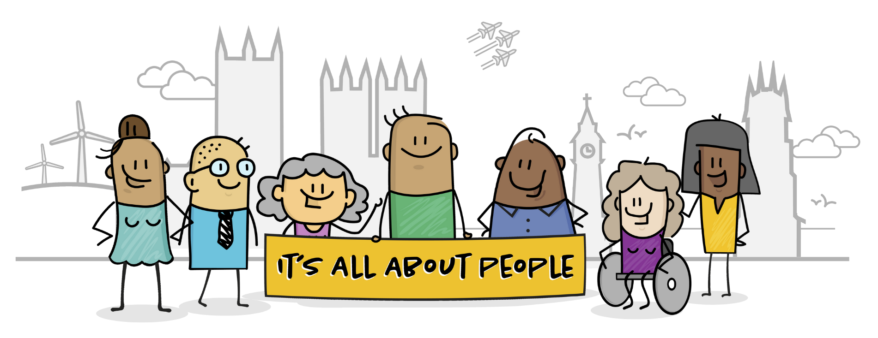
Coming Together A Focus on Personalisation & Co-production
Thursday 20th April 2023
Chris Wheway, Kirsteen Redmile, Vicky Thomson

Slide 2
Notes:
Welcome everyone.
Introduce each of the presenters / facilitators for this workshop – Chris, Kirsteen and Vicky
Any housekeeping for the session
Focus on personalisation and co-production and how VCSE partners can help to promote and develop as a way of working.

Slide 3
Context Personalisation & Co-production in Lincolnshire
Notes:
Recognise that VCSE sector is ‘all about people’. It’s what we do and we are good at it.
Systems are starting to take notice. It is becoming increasingly adopted as a way of working across services and being built into policy and strategy.
SRO for personalisation
Key priority for ICP
Joint Forward Plan
Development of Co-production Strategy for Lincolnshire
Personalisation and Co-production feature in Social Care White Paper
Local Authority CQC – co-production is part.

Slide 4
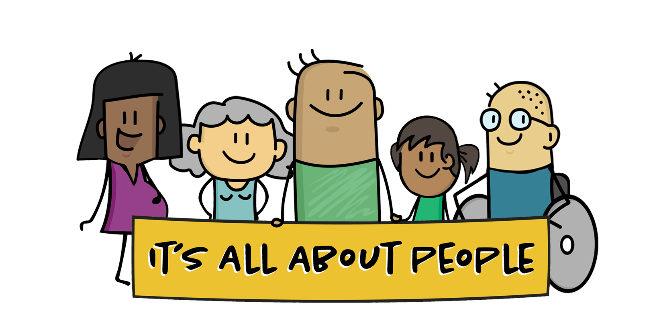
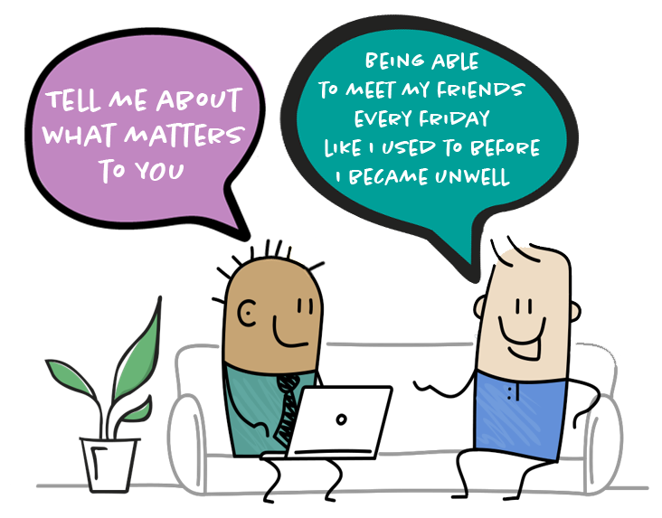
Personalisation
Personalisation is rooted in the belief that people want a life and not a service.
It means people have choice and control over the way their care is delivered.
It focusses on what matters to the person, their strengths, needs and preferences.
In 2019 as part of the NHS Long Term Plan the Universal Personalised Care Model was published with the aiming of shifting and changing the relationship between professionals and people.
www.Itsallaboutpeople.info
Notes:
End with ….
This builds on the approaches and ways of working that social care and community and voluntary sectors services have adopted.

Slide 5
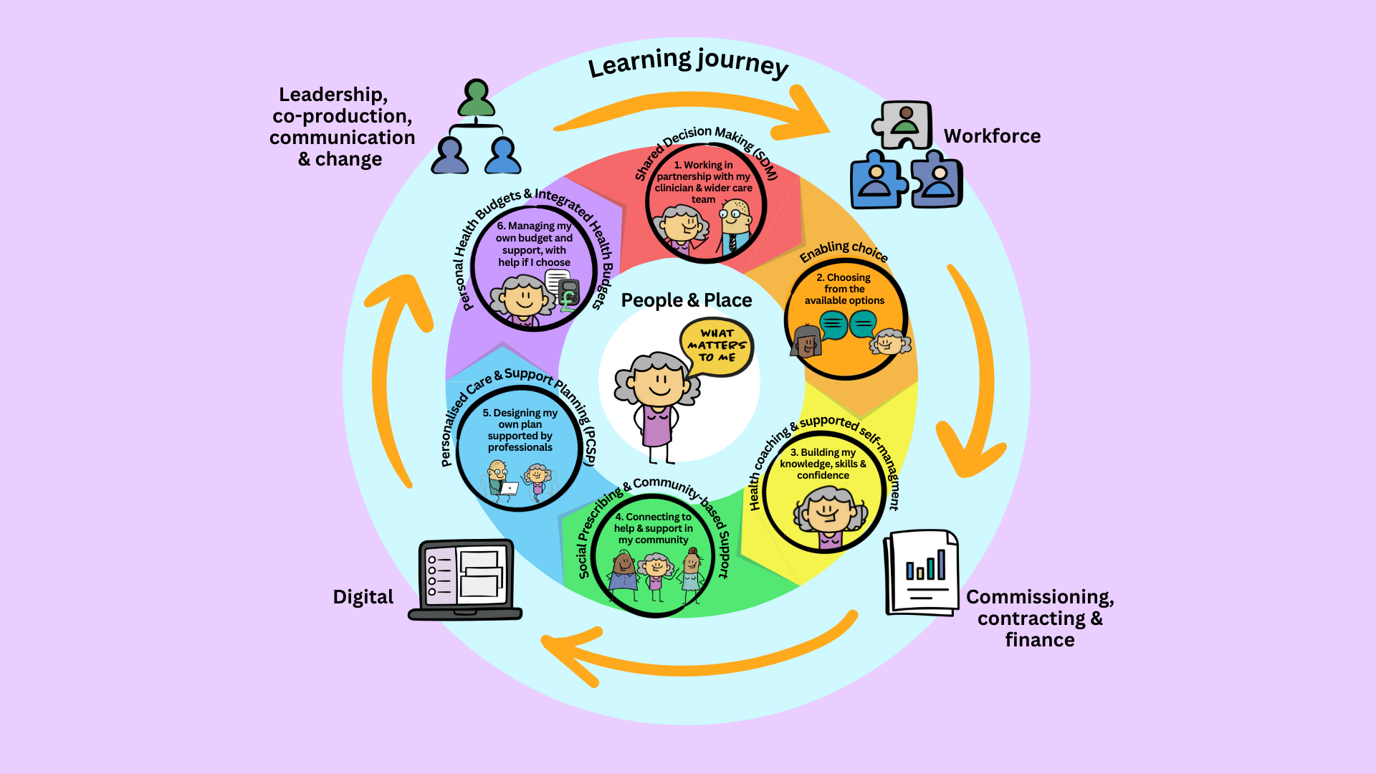
Key Enablers of Personalised Care
Notes:
The 6 Components of Universal Personalised Care alongside the key enablers
People and place
working with and preparing people and communities for strength-based person centred conversations
Understanding and exploring the local community assets
Workforce
Culture and behaviour change
New personalised care roles
Learning and development
Leadership, Co Production, communication and change
Leaders who drive behaviour change
Working with people with lived experience to deliver the messages
Meaningful and relevant information and communication for workforce and people.
Digital
Technology Enabled Care
People driven solutions
Joined up and integrated systems
Commissioning, contracting and finance
Collaborative commissioning – embeds personalised care outcomes, such as;
people who have tailored health and wellbeing conversations see an improvement in their skills, knowledge and confidence in managing their health and wellbeing
Forms part of the ICB service delivery plans

Slide 6
Priorities for 23 /24 :
Embedding the building blocks
Preparing the workforce and people for the shift the conversations to one which focuses on people’s strengths and assets, and ‘what matters’ to them, enabling shared decision making that encourages people and those who are important to them to have more choice and control and be able to live their best and healthiest life.
Training teams and workforce in new tools and techniques, coaching and motivational interviewing, strength-based approaches and starting to understand the impact this is having.
Developing supportive tools, techniques and processes to ease and simplify ways of embedding strength based and personalised approaches into new pathways and service redesign.
Growing the Social Prescribing model in Lincolnshire
Building a social movement of staff and people who are the champions, advocates, and voices of personalised care in Lincolnshire
Co – production – working with people and professionals to develop and improve services for people.

Slide 7
People working together to make things better !
What is Co-production?
Notes:
So remember – it’s just people working together to make things better !

Slide 8
Pathways of experience…
Notes:
We talk about services and pathways and spend a lot of time designing services to meet people’s needs.
If we co-produce with them, they will tell is what their desire lines are.

Slide 9
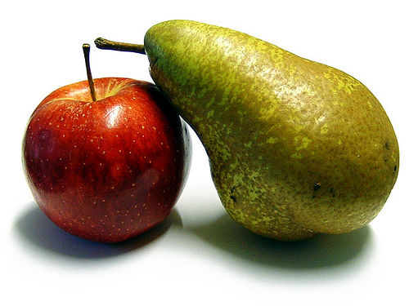
Consultation
Co-production
Notes:
Co-production is a term that is often misused.
Co-production is not about working with colleagues – that is collaboration

Slide 10
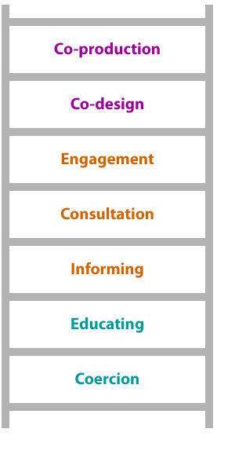
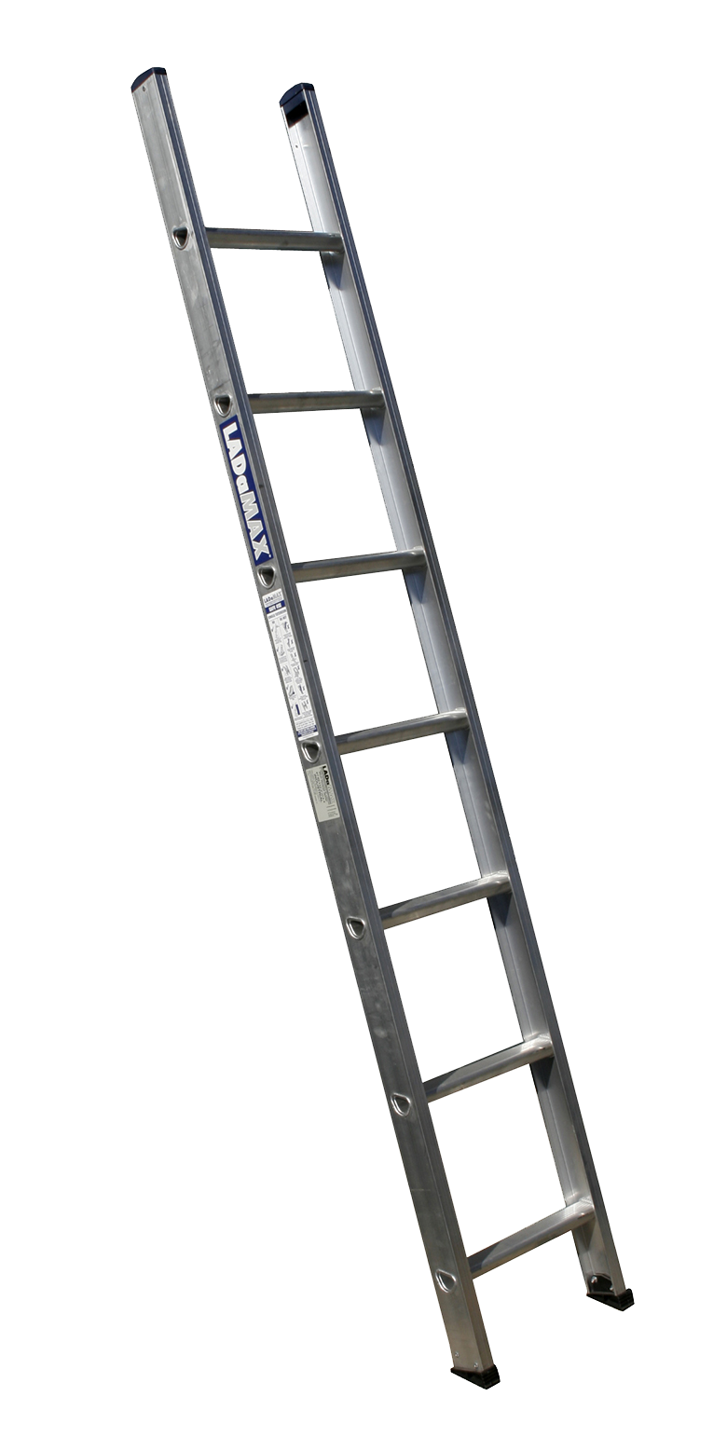
Co-producer
Champion
Petitioner
Lobbyist
Crusader
Follower
Campaigner
Activist
Receiver
Supporter
TLAP (Think Local Act Personal)
©Every-One(Cares)2021
Notes:
Many of you will be familiar with the ladder of engagement suggesting ways we can engage with people ranging from coercion to co-production.
There is a right time and a right place for each of these – not everything can be co-produced. …… if there is a fire today, we will not co-produce our exit, we will be coerced out of the building!
The important thing though is to get the right people around the table for the right thing at the right time.
Whilst this ladder is absolutely right, it comes from the direction of the commissioner …..
---------------------------------------
I believe we also need to look at people’s motivations for engagement?
Champion Petitioner Crusader Lobbyist
Campaigner Receiver Activist Supporter Follower
All are valid and needed – but for true co-production to take place, we need people together who believe in it’s value.
At the top of both ladders if where the magic happens. Where the real difference can be made.
I would say it wouldn’t I, but it is recognised that this is best done with neutral facilitation supporting this magic to happen.
So my advice is either do it and do it well…. Or don’t do it at all.

Slide 11
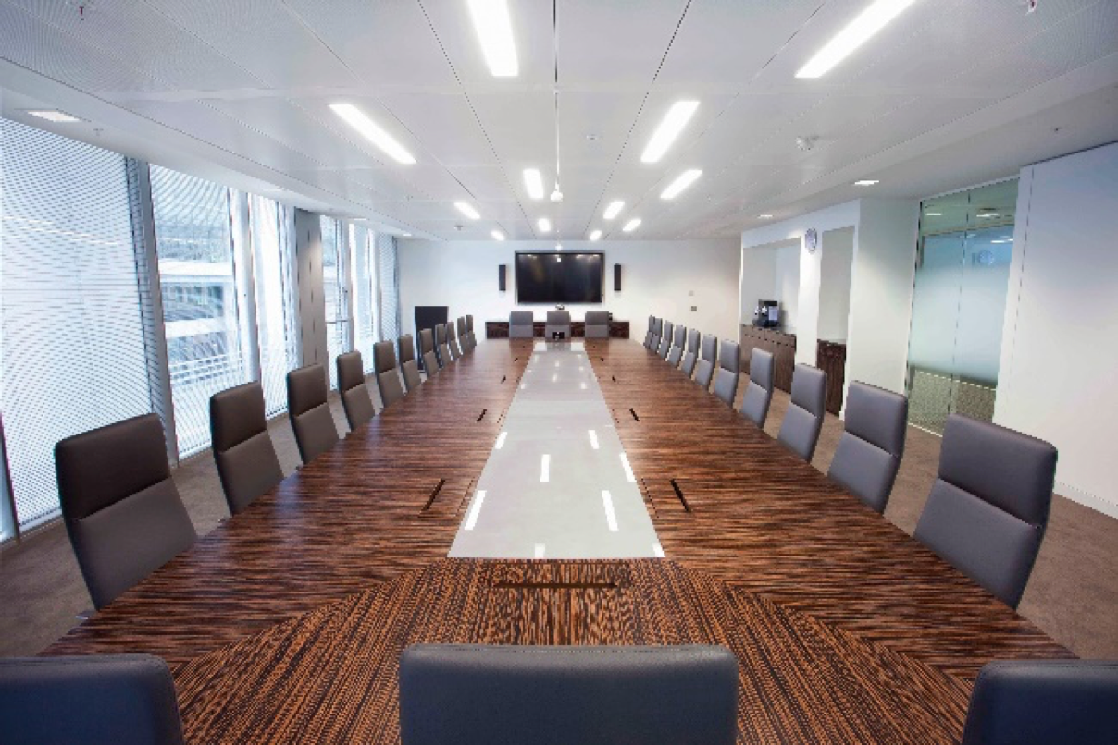
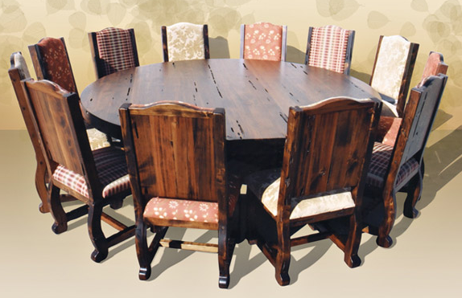
Notes:
How do we come to the table?
It is a long table with sides – them and us?
Or a round table – like a family meal? Everyone equal – no head of table. Everyone can see each other.

Slide 12
Baking our Lincolnshire Co-production Cake
Question 2
What would help you to co-produce what you do?
Question 1
What words are important in describing co-production?

Slide 13
Notes:
Move into Personalisation Programme.
Sense check – what might this mean to you?

