Slide 1
Launch of Greater Lincolnshire as a Social Enterprise Place Allison Webb- Director of External Engagement

Slide 2
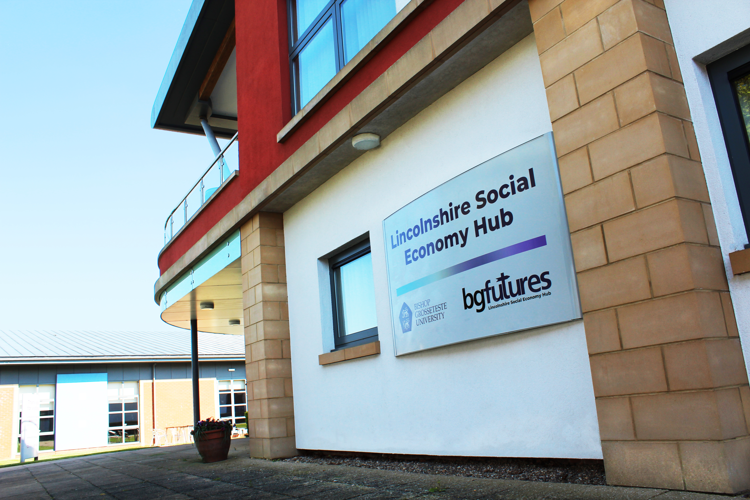
Lincolnshire Social Economy Hub and the Greater Lincolnshire Social Economy Academy

Slide 3
Definition Social Enterprise UK https://www.socialenterprise.org.uk To be a social enterprise a business must: 1) Have a clear social or environmental mission set out in its governing documents and be controlled in the interest of that mission 2) Be independent of state or government control, and earn more than half of its income through trading re-invest or donate at least half of its profits or surpluses towards their mission 3) Be transparent in the way they operate and the impact they have.

Slide 4
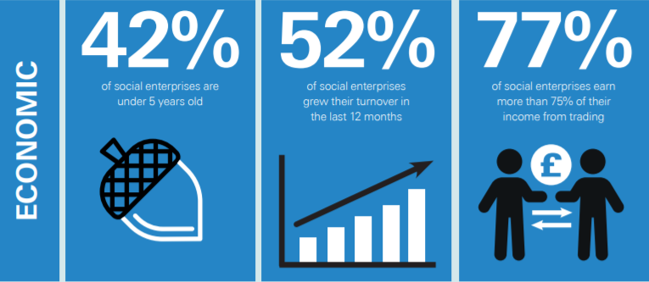
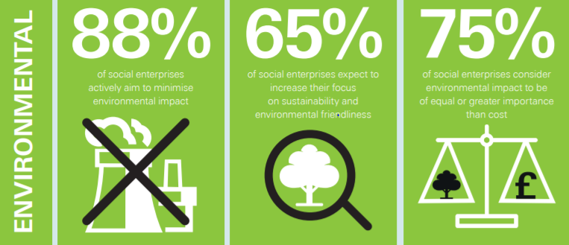
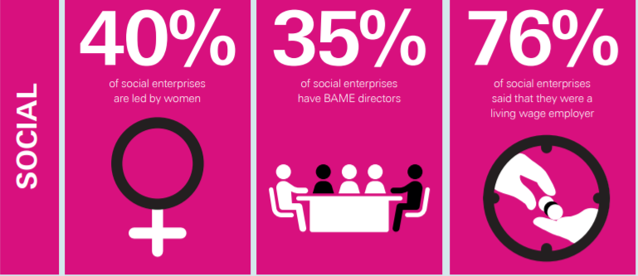
Why?

Slide 5
How it started Established a Steering Group for Social Economy Research and Strategy. Produced a comprehensive research report into the Social Economy of Greater Lincolnshire.

Slide 6
BGU now supporting the Business Lincolnshire offer for the Social Economy, other areas of Greater Lincolnshire supported through Lincolnshire Community Foundation. LVET leading on 4 networking events as part of a joint Social Enterprise Leadership programme with the School for Social Entrepreneurs.

Slide 9
What we need to do -Create a Stakeholder Group- Done -Submit an application -Include an initial report on social enterprise activity Create an action plan Nearly done

Slide 10
The aims of our place
To further understand the make-up and needs of the social economy (including social enterprise) in our area.
To broaden the engagement of the social economy, including social enterprise, raising awareness to encourage start-up, investment and growth of enterprises in Greater Lincolnshire.
To create an environment where the social enterprise sector is healthier and stronger by influencing social value procurement, sustainable trading models, changing the grant reliance culture, skills exchanges and awareness of funding and ‘buy social’ initiatives.

Slide 11
What do we have planned?
The action plan includes the following: Further research, mapping and report Strengthen the voices of those with lived experience Raising awareness in education and training settings General awareness Skills swaps Social investment, funding and a shift from grant reliance The challenges of language and engagement- ‘Doesn’t apply to me…’

Slide 12
Town Drives
A Town Drive is a burst of activity in an area to raise awareness of social enterprise.
Events could include:
Buy Social fair for local businesses
Assembly at local schools
Host a Mapathon to map the social enterprise landscape - Dragon’s Den Competition for secondary school and universities

