Slide 1
Lincolnshire’s Research and Innovation Hub
Paul Holmes: paul.holmes7@nhs.net
Lincolnshire Integrated Care System (ICS) Innovation Lead
Kirsten Guy: kirsten.guy@nhs.net
Lincolnshire Integrated Care System (ICS) Research Lead

Slide 2
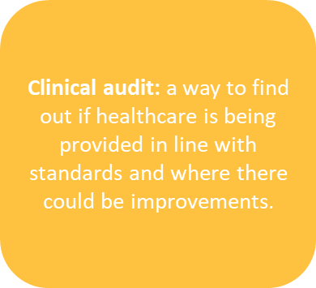
What is Research and Innovation?
Research: the attempt to derive generalisable new knowledge by addressing clearly defined questions with systematic and rigorous methods
Innovation: encompasses
invention and adoption. New ideas are developed to solve problems, improve outcomes, save lives, and the best ones spread quickly for wider benefit
Service evaluation: a process of investigating the effectiveness or efficiency of a service with the purpose of generating information for local decision making about the service.
Quality improvement (QI): “the continual actions to improve outcomes for service users and to develop the workforce that supports them using systematic methods.
Stepping stones
Notes:
Inextricably linked
Research: the attempt to derive generalisable new knowledge by addressing clearly defined questions with systematic and rigorous methods as defined in the UK Policy Framework for Health and Social Care Research
Clinical audit: a way to find out if healthcare is being provided in line with standards and to let care providers and patients know where their service is doing well, and where there could be improvements.
Innovation: The World Health Organization (WHO) explains that ‘health innovation’ improves the efficiency, effectiveness, quality, sustainability, safety, and/or affordability of healthcare. This definition includes ‘new or improved’ health policies, practices, systems, products and technologies, services, and delivery methods that result in improved healthcare.
Service evaluation: a process of investigating the effectiveness or efficiency of a service with the purpose of generating information for local decision making about the service.
Quality improvement (QI): “The continual actions to improve outcomes for service users and to develop the workforce that supports them using systematic methods. The two key elements are ‘continual’ and ‘systematic’. There are many accepted care improvement methods, such as Lean, PDSA (Plan, Do, Study, Act), and Six Sigma.” Taken from Norfolk & Waveney ICB Quality Faculty FutureNHS workspace.
Service evaluations focus on evaluating programmes or projects from a variety of viewpoints e.g. outcomes, satisfaction, implementation, over a defined length of time. QI focusses on an incremental change to a wider programme or project and undertakes analysis in relation to changes to a small number of metrics that determine the impact of that change on patient care/service operation. QI enables changes to be made in real-time in a manner that is (should be) influenced by evidence and evaluation.
The National Institute for Health and Care Research (NIHR) describes two key characteristics that distinguish research and service evaluation: randomisation and generalisability. In a service evaluation there is no randomisation of participants to intervention or control groups. It also states that an evaluation is designed to “define or judge current care”. This means there should be no attempt to generalise the findings of a service evaluation outside the setting/context in which it takes place. Further information can be found on the Health Research Authority website.
Service evaluations, therefore, would not normally include control/usual care groups. Evaluations may assess the impact of an intervention against existing care provision (or pre-intervention) but must not randomise patients or participants to either an intervention or control group.

Slide 3
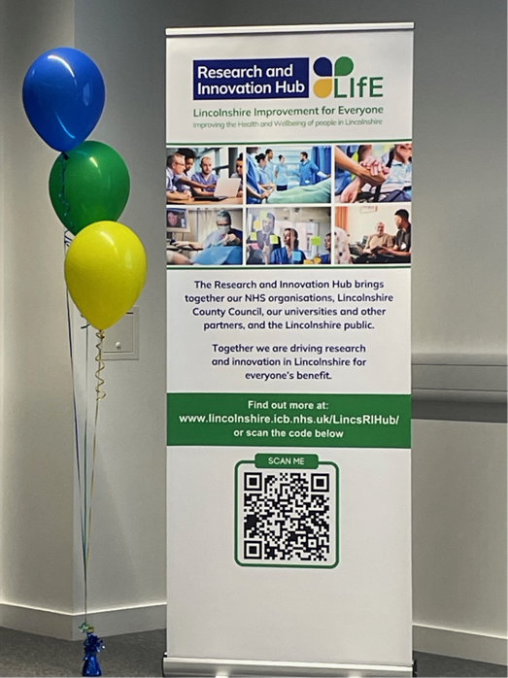
Research and Innovation Hub
The Lincolnshire Integrated Care System (ICS) Research and Innovation Hub is a virtual place that brings together our Health and Care staff, our Lincolnshire public, our colleagues at our universities and other partners to grow research and innovation in our county for everyone’s benefit.

Slide 4
Hub Webpage
www.lincolnshire.icb.nhs.uk/lincsrihub/

Slide 5
Integrated Care System (ICS) Research and Innovation Strategy
Our first ICS Research and Innovation Strategy sets out our collective vision for the next five years.
Developed through a series of collaborative workshops which brought organisations from across the Lincolnshire system together with members of the Lincolnshire public.
Oversight and monitoring is provided by the Research and Innovation Leaders Group

Slide 6
Research and Innovation Hub Webpage
Developed by, and initially focused on the Public, it is a space to:
Find out about health and wellbeing research and innovation in Lincolnshire
Why research and innovation is important
Register to get involved.
Lincolnshire’s Research and Innovation registry is now open!
Read the ICS Research and Innovation Strategy
Now live!
https://lincolnshire.icb.nhs.uk/lincsrihub/

Slide 7
So over to you…
What do you need to be more involved in innovation or research?
What do you need from us?
If innovation and research are about delivering benefits, what benefits are you keen to tap into?
How can we help you?

