Slide 1
Andy Maddison Business Engagement Manager
A Police-Led Partnership Safeguarding Businesses Online
Notes:
So who are Businesses at risk from?
[CLICK]
If it costs a cybercriminal more time/effort to steal your funds or data they are unlikely to bother attacking your company.
Improving your cybersecurity will act as a large deterrent for any cybercriminals, we’ll come back to how later on.
[CLICK]
Indirect attack – Most businesses outsource a proportion of their IT and data to third parties (CRM). Cyber criminals may be able to gain access to a businesses networks and/or information via these companies.
Businesses, in a lot of sectors are stepping in to deliver commissioned services for local authorities and central government. In carrying out these contracts there is often a need to share systems and data with those larger organisations. It is possible, that in doing so they may be seen by cyber criminals as an easy route to get to the ‘bigger fish’.
[CLICK]
An insider breach (STAFF ERROR OR ASSURANCE FLAW etc is not necessarily intentional. Could be an error downloading from a phishing email or accidental download | They may also be using a weak password which is easily guessed by an attacker |.
We have to trust staff members to use the businesses IT systems and software safely and legitimately, however this trust has risks attached. Disgruntled users could pass on credentials to attacks, introduce malicious software to the system or steal data from the organisation.

Slide 2
Our coverage area
Derbyshire
Leicestershire
Lincolnshire
Northamptonshire
Nottinghamshire
Rutland

Slide 3
Community
Regular newsletter, easy to understand updates and free information pack
Impartial guidance for charities, schools and businesses
Opportunities for joint working to raise awareness (like LVET!)

Slide 4
Partnerships
Working with local and regional policing across the East Midlands
National Cyber Security Centre and Action Fraud
Cyber Essentials partnership

Slide 5
Affordability
Lots of free resources on our website from the National Cyber Resilience Centre
Working with local Universities to deliver high-quality services
Affordable cyber-security services called CyberPATH

Slide 6
CyberPATH Services
Security Awareness Training
First Step Web Assessment
Web Application Assessment
Internal Vulnerability Assessment
External Vulnerability Assessment
Individual/Corporate Internet Discovery (OSINT)
Business Continuity Review / Security Policy Review
www.emcrc.co.uk

Slide 7
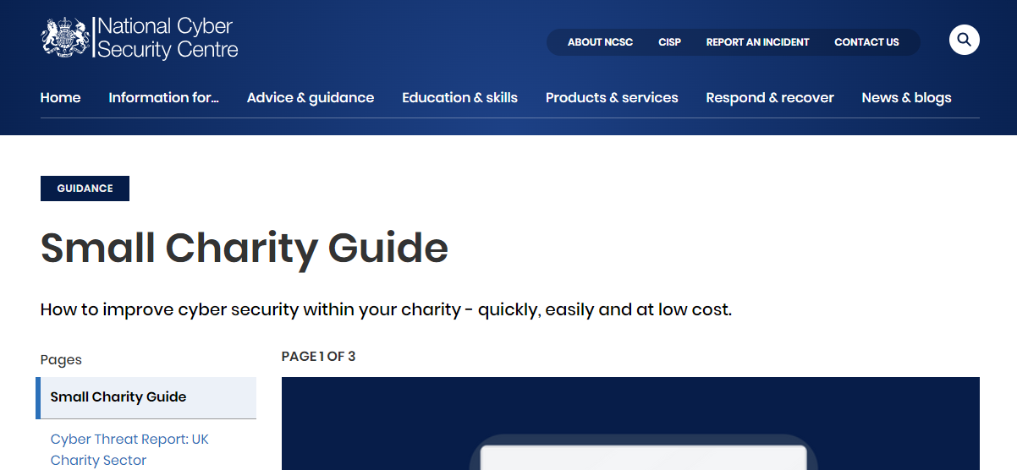
www.emcrc.co.uk

Slide 8
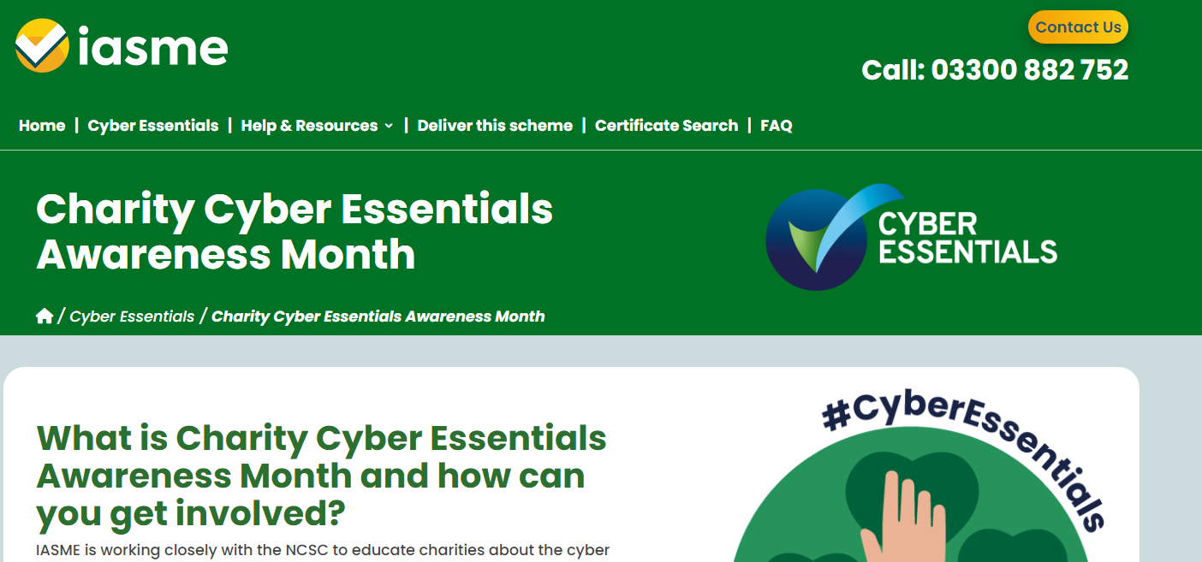
www.emcrc.co.uk

Slide 9
Further information available on our website
www.emcrc.co.uk

