Slide 1
Research Engagement Network (REN) Programme
Notes:
Welcome to a short presentation on the Research Engagement Network (REN) programme!
This presentation will cover the following topics:
What is the Research Engagement Network (REN) Programme?
What is Research? What is Innovation?
What are the benefits of people getting involved in research? Why does diversity matter?
The Research Charter – how would you like to be treated when taking part in research?
Health, Social Care and Wellbeing Research Fund
Ways you can get involved in research and engagement
How to find out more

Slide 2
What is the REN Programme?
A Collaborative approach – partners coming together
Funded by NHS England, with Lincolnshire in year 2 of the programme
The primary aim is to increase diversity in research
Notes:
What is the Research Engagement Network (REN) programme?
A collaborative approach
The REN programme brings together partners from the University of Lincoln, LVET, Every-One, HW Lincs, Lincolnshire ICB, Lincolnshire Health Trusts, Lincolnshire County Council and NIHR, all working towards a shared goal.
Funded by NHS England
The programme is funded by NHS England, and available across the country. Lincolnshire is now in year 2 of the programme.
Primary Goal
The REN programmes primary aim is to increase diversity in research. We hope to make research more accessible and relevant, and engage people from diverse backgrounds, communities and experiences to consider taking part in research!
Key activities for the programme
Talking to people and communities, raising awareness of research
A Health, Social Care and Wellbeing Research Fund for communities to develop small research projects
Continuing to build links and relationships with those who are involved in research activity
Developing an information pack which supports all to feel more empowered and confident in talking about research.
More Information
For more information on the REN programme, visit www.lvet.co.uk

Slide 3
Research, Engagement and Innovation – What are they?
Research is… looking into something in more detail to understand it better.
Engagement is… involving people, listening to their views, opinions and experiences.
Innovation is… creating new ideas, methods, products or ways of working that either improve things or solve problems.
Notes:
What is Research?
People often hear the word research and think of a clinical trial, academia or just that its simply not for them, amongst other things! Research is the investigation of a specific question, issue or problem, or simply looking into something in more detail to understand it better. It helps to answer questions, solve problems or discover new things. Within this programme, we will be referring to both researchers and organisations who undertake research activity.
What is Engagement?
Alongside research, there’s engagement. Engagement is involving people, listening to their views, opinion and experiences, and working together. Both are wanting to understand things in more detail.
There are three main types of research – academic, clinical and communities. Within each of these, there are different methodologies, such as surveys, experiments and interviews.
Examples of research include…
What is Innovation?
Innovation is often paired with research, and again people can at times think it isn’t something they do, and lots of organisations do this! Innovation is all about creating new ideas, methods, products or ways of working that either improve things or solve problems. This is a huge strength within the voluntary, community, faith and social enterprise sector.

Slide 4
Why does research matter? Why should you get involved? Why is diversity important?
Essential in everyday life!
There are many benefits of being involved in research, such as making a difference, having your voice heard and improving your local community.
Diversity is key as it offers broader, different and unique perspectives on a topic.
Notes:
Why does research matter?
Research is essential in everyday life.
It helps improve our understanding, learning more about issues, challenges, needs and solutions.
It informs decisions, providing an evidence base to make informed decisions
It moves things forward, and leads to new ideas, change and innovation.
Why get involved in research? What are the benefits for people?
There are many benefits for people to get involved in research, and all have various importance depending on the person taking part. Some benefits include:
Learning new skills, knowledge and information on specific topics
Connecting with others, working alongside researchers and other people
Improving your local community, helping to address local issues or community needs
Making a difference, helping to shape solutions to real world problems, and improve lives.
Having your voice heard, sharing your experiences and perspectives to influence things.
So why does diversity matter in research?
It offers broader perspectives, bringing different and varied ideas and opinions. A wider range of view helps researchers avoid assumptions or biases too.
The relevance of the research is increased through including as many voices as possible. Alongside this, when including information from diverse groups of people, the findings become more relevant and applicable to different communities.
Diversity often encourages creativity and innovation through the unique insights gathered from different experiences.
From a health perspective, diversity is key to understanding differences and disparities across different populations. It can also identify specific needs or inequalities

Slide 5
What is the Research Charter and Why?
Three Primary Goals:
Empower people to take part
Build trust between communities and researchers
Increases clarity and consistency to the research experience
Funding between October 2024 – March 2025 to coproduce and codevelop a Research Charter.
A Research Charter is… an agreement between people and researchers on what they can expect when taking part in research activity
Links closely with the REN Programme
Notes:
Alongside the REN programme, we’re also coproducing a Research Charter.
Funding through NIHR was available to develop a Research Charter in Lincolnshire, between October 2024 and March 2025. LVET are leading on the development, working with partners of the REN steering group, other researchers or organisations who undertake research activity and communities in a co-produced, co-developed way.
What is the Research Charter?
A clear, shared agreement between people, researchers (or organisations undertaking research activity), which includes what all parties can expect, such as being treated with respect, fairness and transparency.
Three primary goals of the Research Charter:
Helps people feel confident and respected in research, empowering them to take part
Builds trust between communities and researchers
Adds clarity and consistency to the research experience
We are developing the charter through both learning from what already exists, as well as coproduction with researchers, organisations who undertake research / engagement activity and people!

Slide 6
Share your thoughts - What do you think?
What would you like to know before you take part in research?
Key information you’d like to help you decide whether to take part
What would you like to know after you’ve taken part in research?
How do you expect to be treated by the research team / if taking part in any kind of research activity?
How do you want to feel taking part in research?
Notes:
The Research Charter will include perspectives from both researchers and organisations who involve people in research or engagement activity.
We’d love your input in shaping what this looks like and you’ll have an opportunity in a few minutes to complete the survey within the meeting (as we do appreciate everyone is busy)! We’re currently reviewing what’s in place in other areas to see what we can learn, and we’re keen that local input is included in the charter from the start. Even if you’ve not been involved in research before, please do share your thoughts on you’d expect taking part and what you’d like to know!
There are four questions we would like to gather your thoughts on:
What would you like to know before you take part in research? This is key information you’d like to help you decide whether to take part
How do you want to feel taking part in research?
What would you like to know after you’ve taken part in research?
How do you expect to be treated by the research team / if taking part in any kind of research activity?
**Need to think about how this would be delivered in a live setting for responses to be captured**

Slide 7
What’s important to you?
Not Important
Extremely Important
1. Feel supported to ask questions
6. Fully understand the purpose, goals and potential impact
4. Kept up to date of progress on a regular basis
2. Be treated with respect
7. Be compensated for my time
5. Be informed of the results
3. Be spoken to in plain language
8. Offered further research opportunities
Notes:
When we are thinking about research and you being involved in research activity, we are keen to understand what is important to you. From the conversations and learning we have done so far, we have a couple of ideas on things which may be included in the Research Charter. We’d love to know your thoughts on how you would prioritise these, from not important to extremely important.
We have 8 statements below:
Feel supported to ask questions
Be treated with respect
Be spoken to in plain language
Kept up to date of progress on a regular basis
Be informed of the results
Fully understand the purpose, goals and potential impact
Be compensated for my time
Offered further research opportunities
How would you rank these in relation to each other? This will help us to structure the charter.
**Need to think about how this would be delivered in a live setting for responses to be captured**

Slide 8
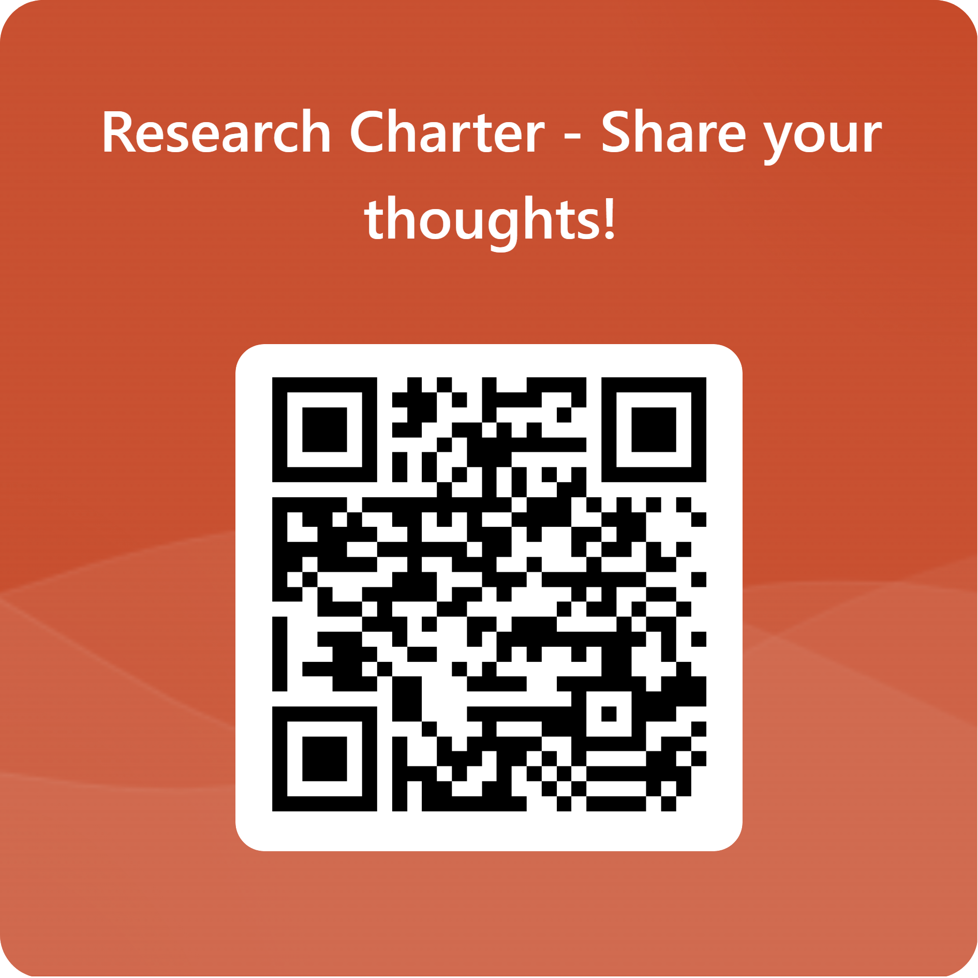
Complete the Research Charter Survey
Notes:
If you haven’t done so already, please spend 5 minutes completing the survey either now or at the end of the meeting.

Slide 9
Health, Social Care and Wellbeing Research Fund
Coming soon!
Purpose… to help Lincolnshire communities lead their own health, social care or wellbeing research projects based on local needs.
There are 5 key criteria:
Community Led focus
Community Benefit
Health, Social Care and Wellbeing Relevance
Community Relevance
Doable
Notes:
We’re imminently launching a health, social care and wellbeing research fund so watch this space! The purpose is to help Lincolnshire communities lead their own health, social care or wellbeing research projects based on local needs.
There are likely to be 5 key criteria:
Community Led focus
Community Benefit
Health, Social Care and Wellbeing Relevance
Community Relevance
Doable
More information will follow over the coming week!

Slide 10
Get involved!
Developing the Research Charter
Research and Innovation Hub
Healthwatch
Every-One
Be Part of Research
Join Dementia Research
Notes:
There are many ways you can get involved in research! Examples of some live opportunities are…
You can join a working group to help shape the Research Charter by emailing Emily Ward (Emily.ward@lvet.org)
If you’d like to explore research opportunities locally in Lincolnshire, visit the Lincolnshire Research and Innovation Hub - https://lincolnshire.icb.nhs.uk/lincsrihub/be-part-of-this/
If you’d like to share your experiences to improve care in your community, visit https://www.healthwatch.co.uk/
If you’d like to join a co-production group working together to share services, visit https://every-one.org.uk/
There are also national studies you can get involved in, such as Be Part Of Research (https://bepartofresearch.nihr.ac.uk/) or Join Dementia Research (https://www.joindementiaresearch.nihr.ac.uk/)

Slide 11
For more information, contact…
Emily Ward
Project Development Manager
Lincolnshire Voluntary Engagement Team
Emily.ward@lvet.org
07888 330294
www.lvet.co.uk
Notes:
For more information, Emily Ward from LVET is coordinating the REN programme and leading on the development of the Research Charter and is more than happy to be contacted!
Email: Emily.ward@lvet.org
Phone: 07888 330294
Website: www.lvet.co.uk

