Slide 1
Who are we?
Young Gamers & Gamblers Education Trust
Preventing children and young people from experiencing gaming and gambling harms through awareness raising, education and research.

Slide 2
Why are we needed?
99% of delegates felt better equipped to identify and respond to gambling harms following Ygam training.
Ygam Impact Report 2023
Prevention of these harms may not always be at the top of the pile of public health priorities; nevertheless, they are an increasingly essential part of protecting young people growing up in a digital world.

Slide 3
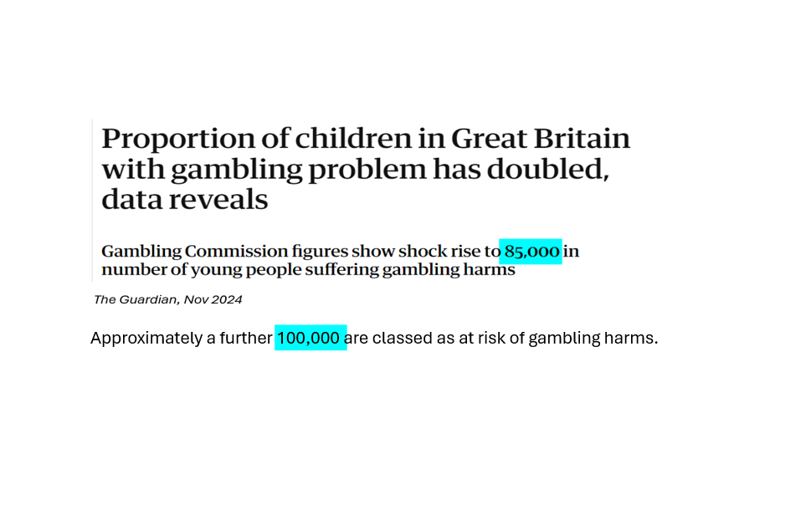

Slide 4
100% Free Training
What we offer?
Our free of charge (fully funded), evidence based, CPD training covers a range of topics and is informed by psychologists, academics, health professionals and those with lived experience.
Multiple tailored programmes
Booked over Teams at a date/time that suits you
Interactive and accessible going through a range of topics and advice
City and Guilds Assured- All participants receive a C&G certificate
Attendees get access to a bank of many useful resources including conversation starters, screening questionnaires and activity ideas
Access to further specific alumni newsletter and sessions in the future which include cryptocurrency

Slide 5
What we cover
🧠 Mental Health and Wellbeing.
🎮 Gaming and Gambling harms.
🕹 The blurred lines between gaming and gambling.
Media and advertising.
🗣️ Starting conversations around gaming and gambling with young people.
🔎 How to spot signs of harm.
👨‍⚕️ Where to get help and support.
+ More

Slide 6
Full Workshop Outline
Interactive
Gambling
Influences
Harm
Gaming
Harm
Digital Convergence
Barriers
How you can help
Resources
Lived Experience
Resources

Slide 7
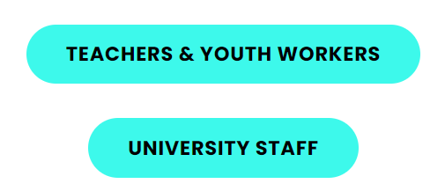
Who is it for?
Any professional (including volunteers) that works with Children and Young people ( Those under 25).
Different programmes to suit different areas:

Slide 8
LVET Partnership
LVET are working in Partnership with YGAM this March by hosting a FREE CPD online workshop exclusively for LVET members.
March 6th 14.00—16.00
For Healthcare professionals. (Those that work in the health and wellbeing sector such as medical, community support, mental health, social prescriber professionals and volunteers)
Hold the date! (Details to follow)

Slide 9
How to get involved?
Join us for our LVET Partnership on March 6th
Book in a bespoke session for teams of 10+ directly with me ryansmith@ygam.org
Register onto one of our monthly open sessions through our website here.

Slide 10
Any Questions?
Although we only offer preventative education and tools to those working with young people, we signpost to fantastic organisations that offer direct support such as:

