Slide 1
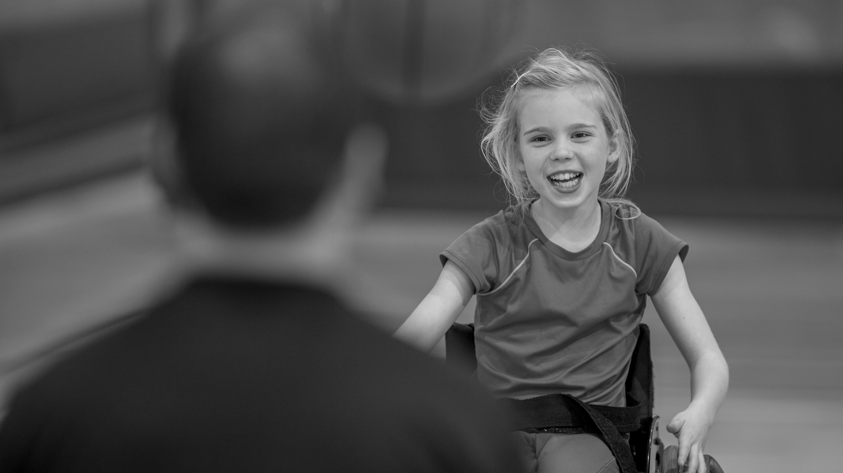
Diversity and Inclusion
April 2025

Slide 2
Who are we.
Active Lincolnshire is dedicated to making physical activity accessible to everyone in Lincolnshire, aiming for "More people, more active, more often." As one of 43 Active Partnerships in England, it collaborates with partners to address inactivity and inequalities, delivering Sport England's 'Uniting the Movement' strategy locally.
We focus on providing positive experiences, advocating for the benefits of physical activity, and integrating movement into policies and education. Through the County strategy “Let's Move Lincolnshire”, it strives to create conditions for a more active population, improving lives across the county.

Slide 4
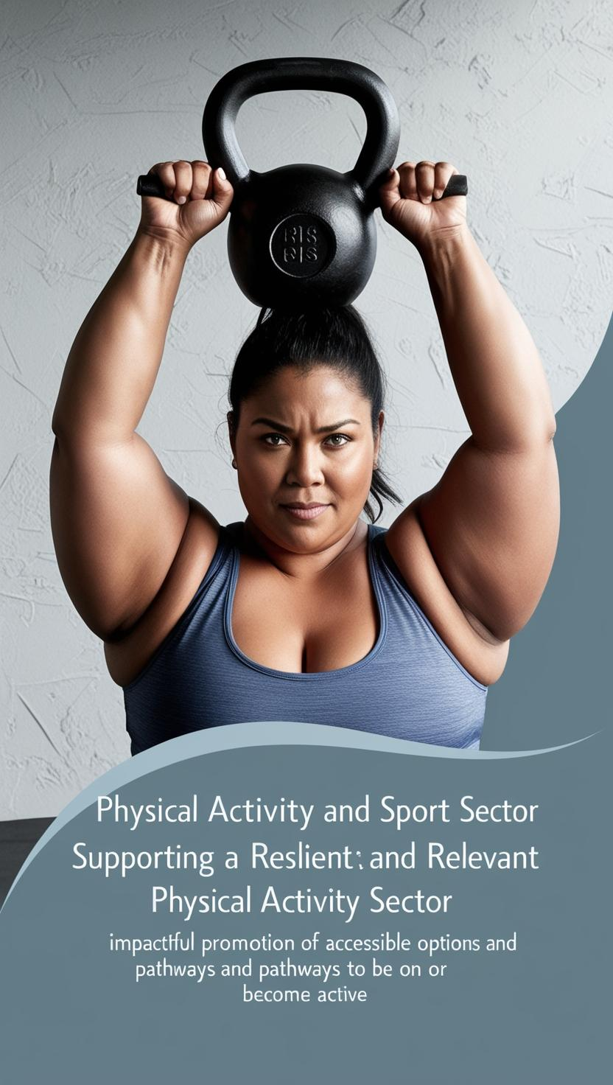
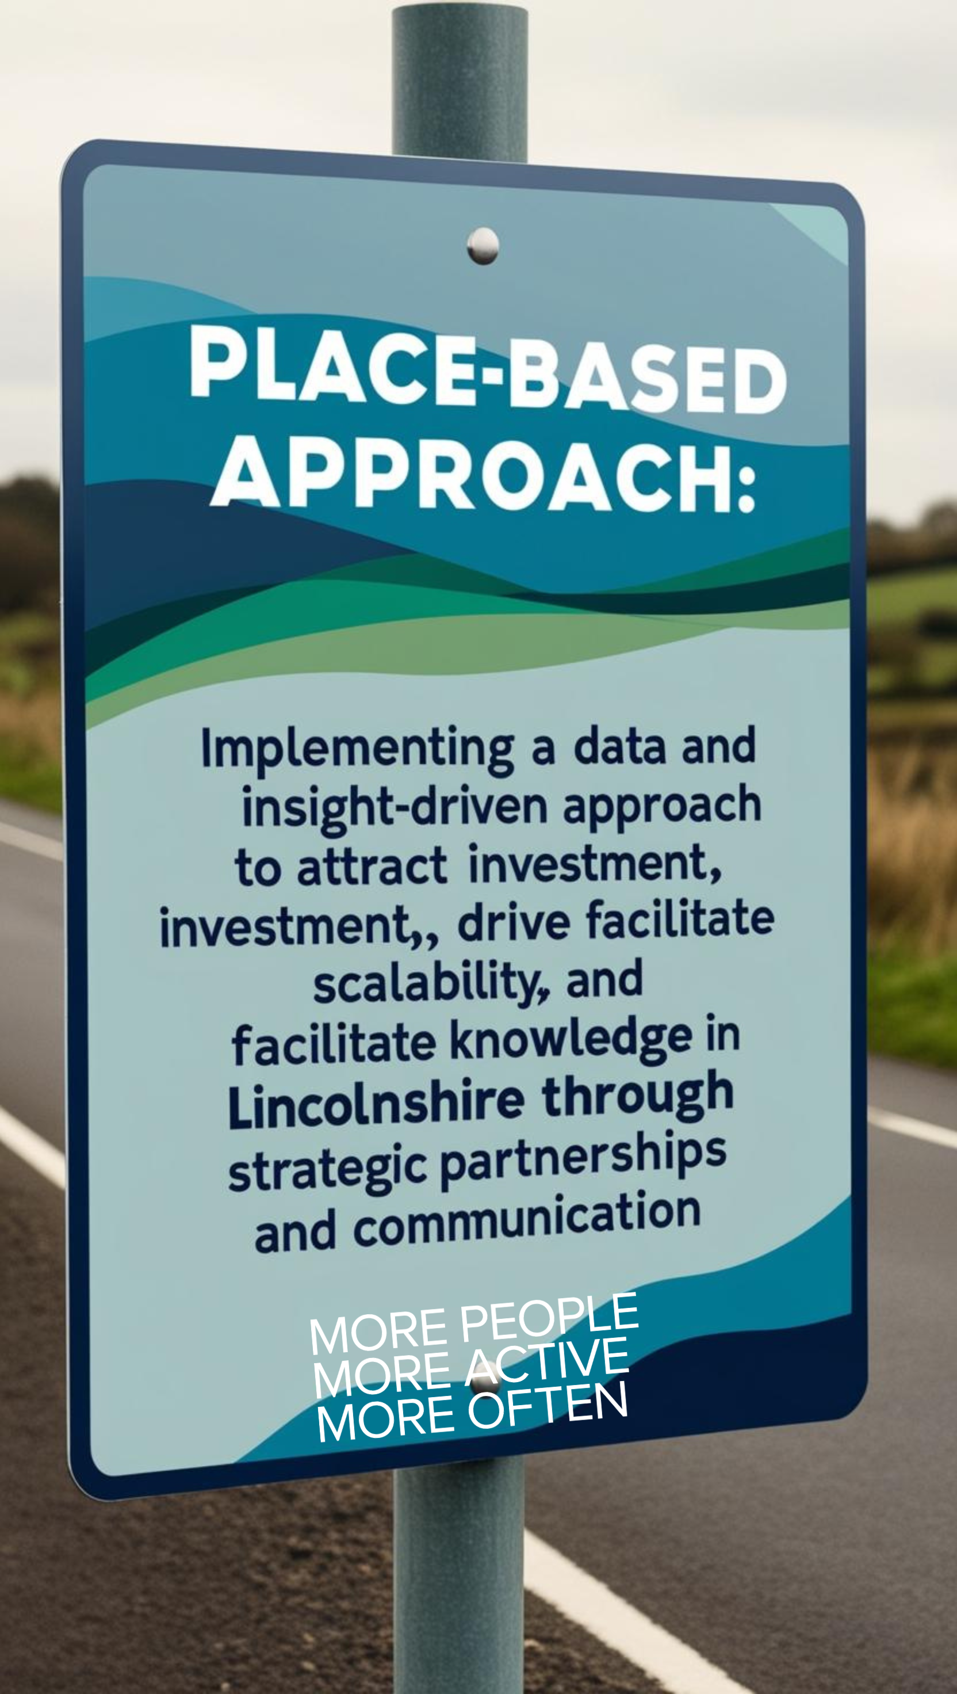
Notes:
Supporting the physical activity and sport sector
Supporting a resilient and relevant physical activity sector, impactful promotion of accessible options and pathways to be or become active.
Place Based Approach
Implement a data and insight driven approach to attract investment, drive scalability and facilitate knowledge exchange in Lincolnshire through strategic partnerships and communication.
Let’s Move Lincolnshire
Convene & connect to support the LML movement and shared delivery plan. Engaging stakeholders and showcasing our collective impact on reducing the inequalities in physical activity.

Slide 5
Our Work As advocates for the positive power that physical activity has on everyone’s lives, we work in partnership to improve understanding, influence change, and tackle the challenge of inactivity.
Addressing health inequalities: Working with partners to ensure the provision of inclusive, accessible opportunities for physical activity, targeting communities disproportionately affected by health disparities. ​
Collaborating with partners: Working alongside various organizations to address barriers to physical activity, leveraging expertise, data, and networks to create meaningful impact in local communities.
Creating active environments: Supporting community-focused, environmentally sound, and financially sustainable initiatives that contribute to reducing inequalities and help people move more. ​
Delivering training and courses: Organizing workshops and courses to upskill individuals in the sport and physical activity sector, enhancing the quality and accessibility of activities. ​
Developing and implementing the Let's Move Lincolnshire strategy: A 10-year plan aimed at encouraging everyone in Lincolnshire to be more active, with a focus on addressing inactivity and inequalities.
DIAP (Diversity Inclusion Action Plan): Leadership, Governance & Compliance, Data & Insight, Our People & Culture and Stakeholder Participation & Sector Engagement.
Engaging in campaigns: Participating in and promoting local and national campaigns to raise awareness about the benefits of physical activity and encourage community involvement. ​
Offering funding opportunities: Providing access to various local and national funding sources for sports clubs, schools, and community groups to support physical activity projects. ​
Promoting active travel initiatives: Encouraging walking and cycling as part of daily routines to embed physical activity into everyday life and support healthier communities.
Supporting social prescribing networks: Collaborating with health and care professionals to integrate physical activity opportunities into healthcare, including initiatives like social prescribing to improve mental health and well-being. ​

Slide 6
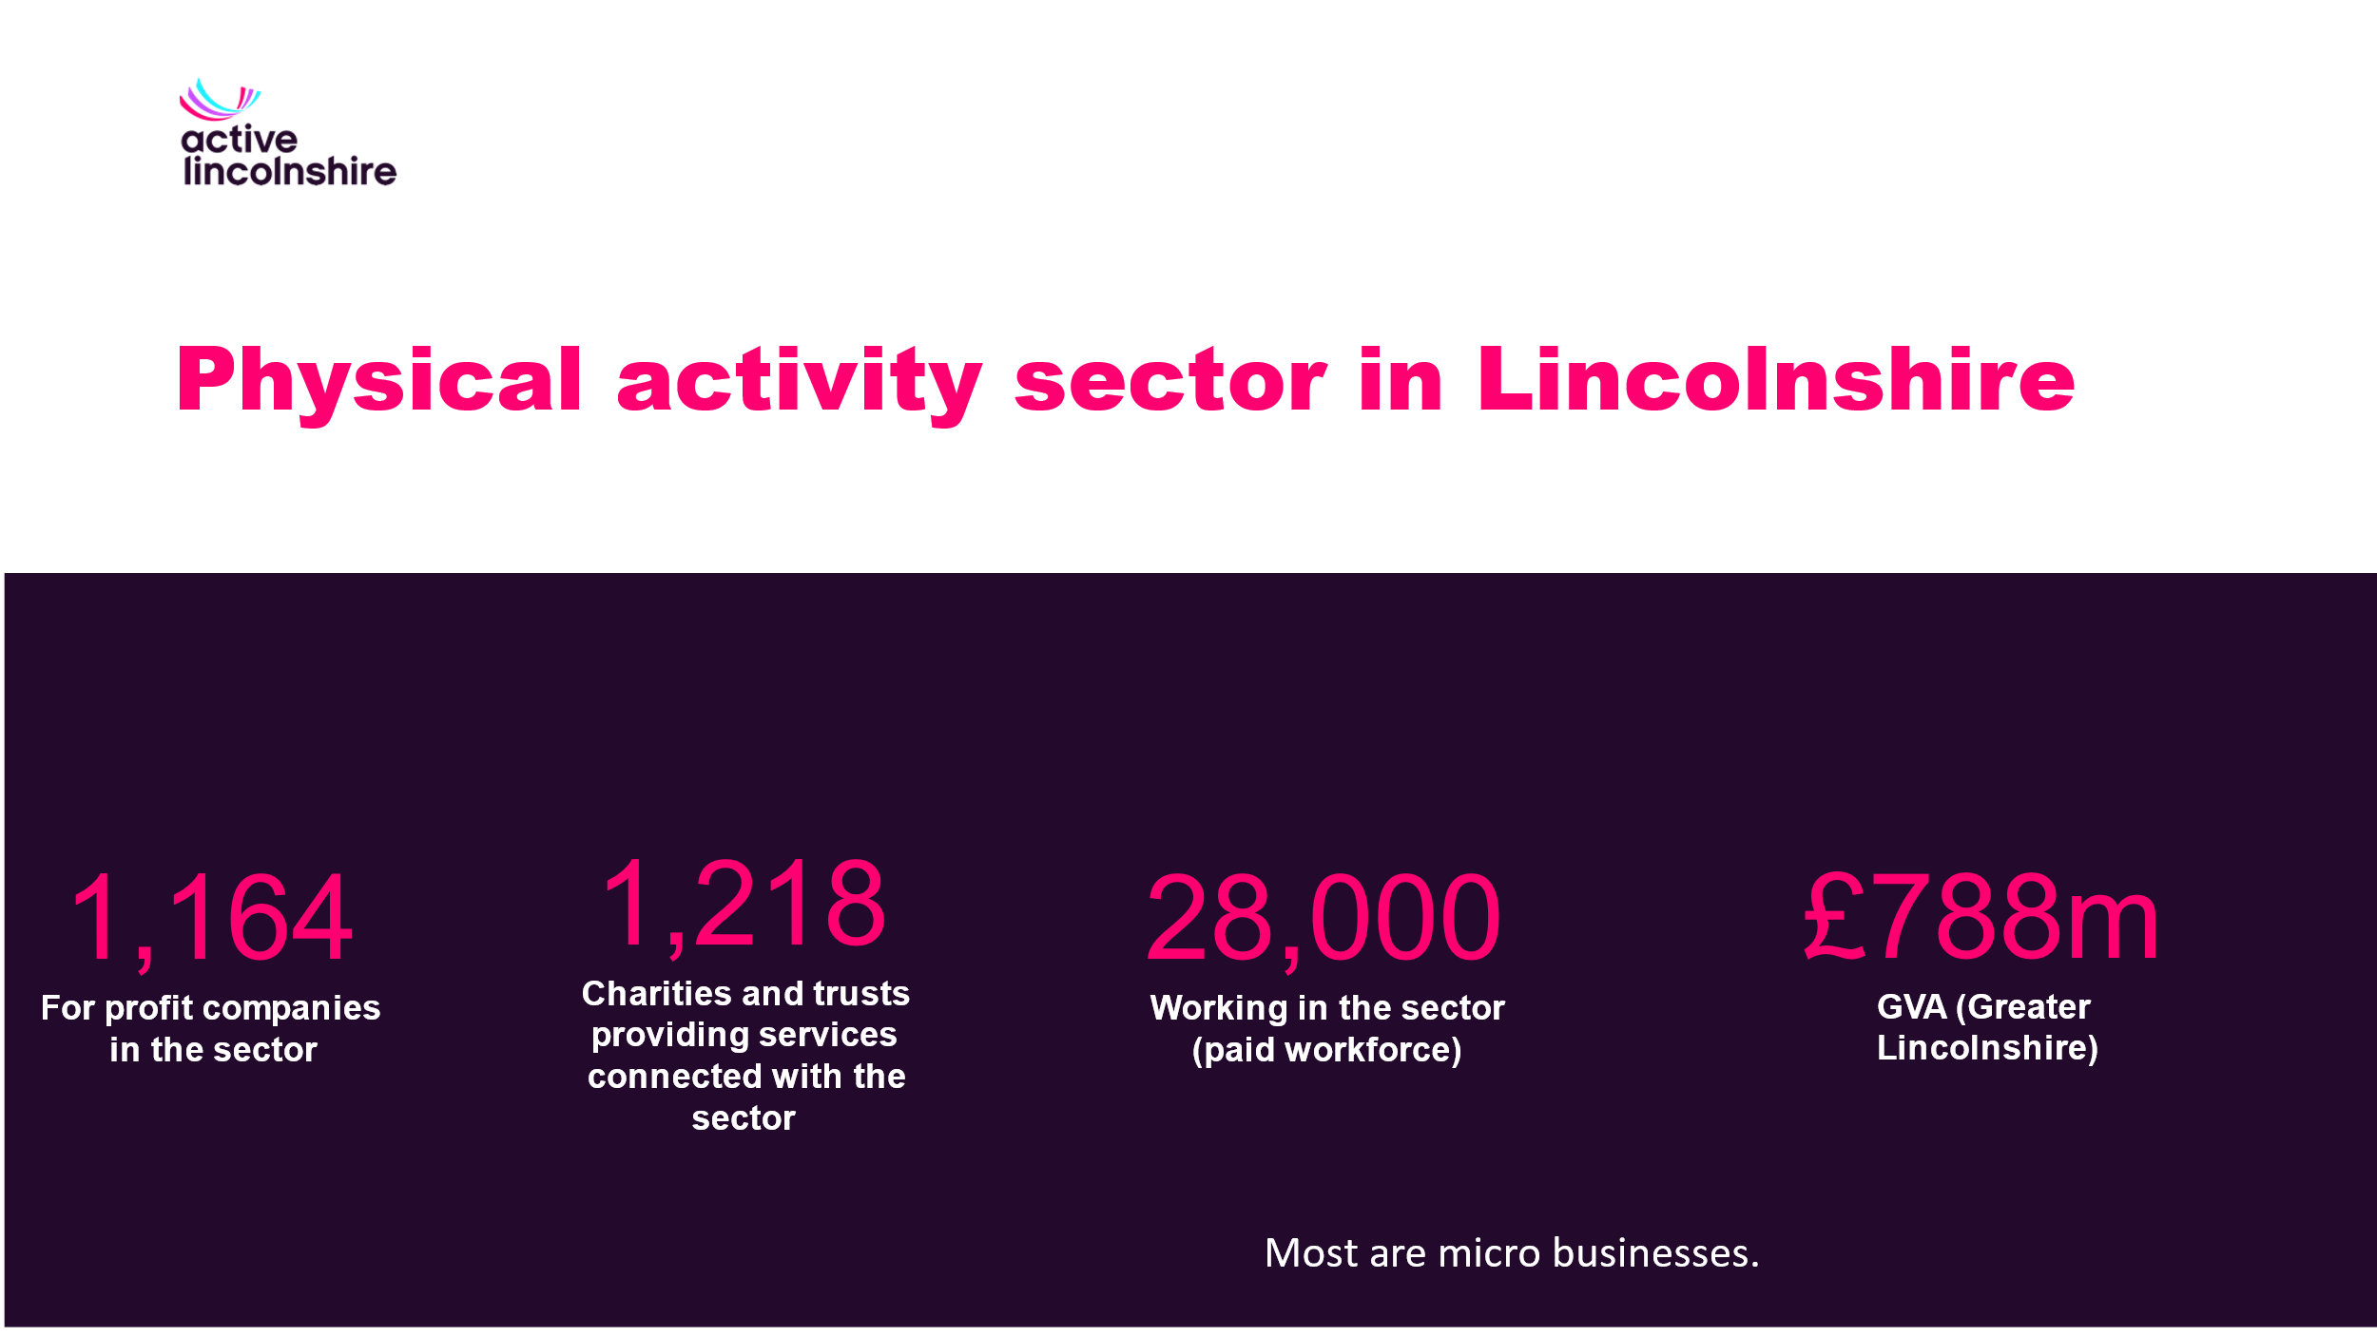

Slide 7
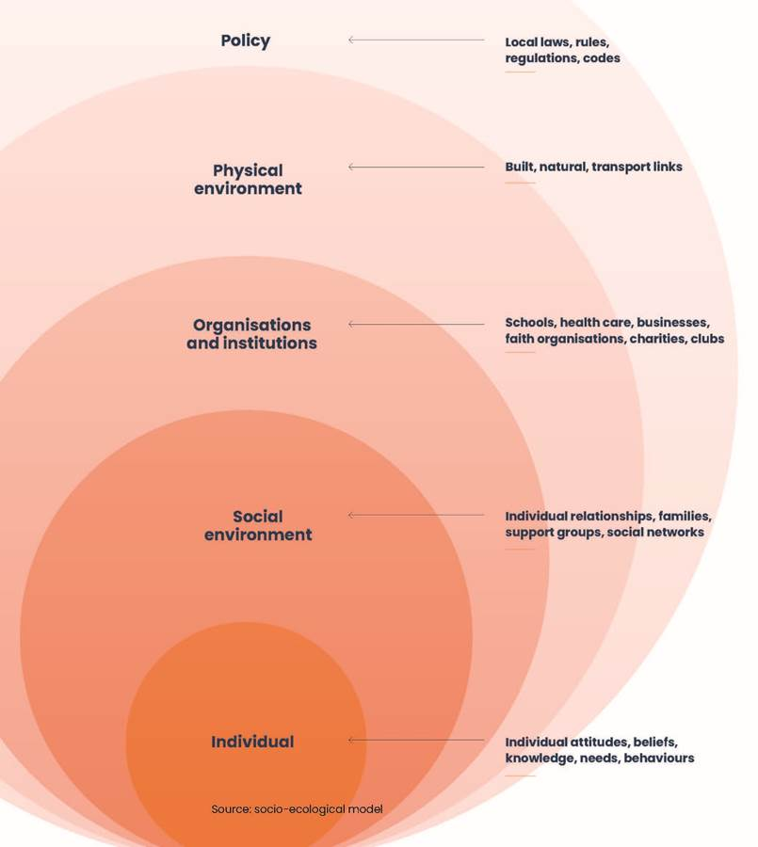
East Lindsey District Council Investment Fund Eligibility/Supporting documentation If applying for playground equipment, please submit an accessibility audit which evidences inclusive access and play for users and caregivers with various disabilities including mobility, vision, hearing and sensory such as autism spectrum disorder.
Funding eligibility,
Developing a Play strategy
Talking to planners, collecting resources
Invited to our AGM to tell her story
Not able to interact with her brother or other children
A child not able to access a play park
Notes:
Lorna Fillingham - Campaigner & advocate for better disabled access and facilities – Scunthorpe
Told her story at our AGM in Boston – She also did a session with the staff team.
Conversations with Scope and sharing of resources – as well as regional meetings DRC
Talking to planners – SEL play park strategy
Discussions at panel meetings led to it now being a condition of the grant.

Slide 8
Religion or belief
51%
1,751
413,585
2,298
657
5,800
657
3,831
290,242
47,060
Buddhist
Christian
Hindu
Jewish
Muslim
Sikh
Other religion
No religion
Prefer not to say
0.2%
54.0%
0.3%
0.1%
0.8%
0.1%
0.5%
37.9%
6.1%
766,100
49%
ID
Lincolnshire
CoL 1% 1,048
NKDC .27% 319
19.1% have a disability
154,573 (26.8% of households)
White 96% (737,532) made up of:
White British (89.2%), Irish (0.4%), Gypsy or Irish Traveler (0.1%), Roma (0.1%) or
other white background (6.1%).
Asian/ Asian British 1.4%
Mixed/ multiple ethnic groups 1.3%
Black/ African/ Caribbean/ Black British 0.6%
National identity
89.6% British and English
Notes:
Greater Lincs disability 20.1% 219,906
East Lindsey 9.9% 16,149 were limited a lot 12.3% limited a little 22.5% in total
ELDC has 22.2% (31,080 people) with a disability or long-term health condition and the highest proportion of two or more disabled people within a household in the English local authorities at 10.3% of households.

Slide 9
The national and local data and intelligence therefore highlights the need for Active Lincolnshire’s work and our role in influencing and advocacy to focus on:
Women and girls
Ethnically diverse communities
People with a disability
People from lower socio-economic groups (6-8)
LGBTQIA+ people
People with limiting illness or condition
Older adults
Active Lincolnshire – Inclusive Language

Slide 10
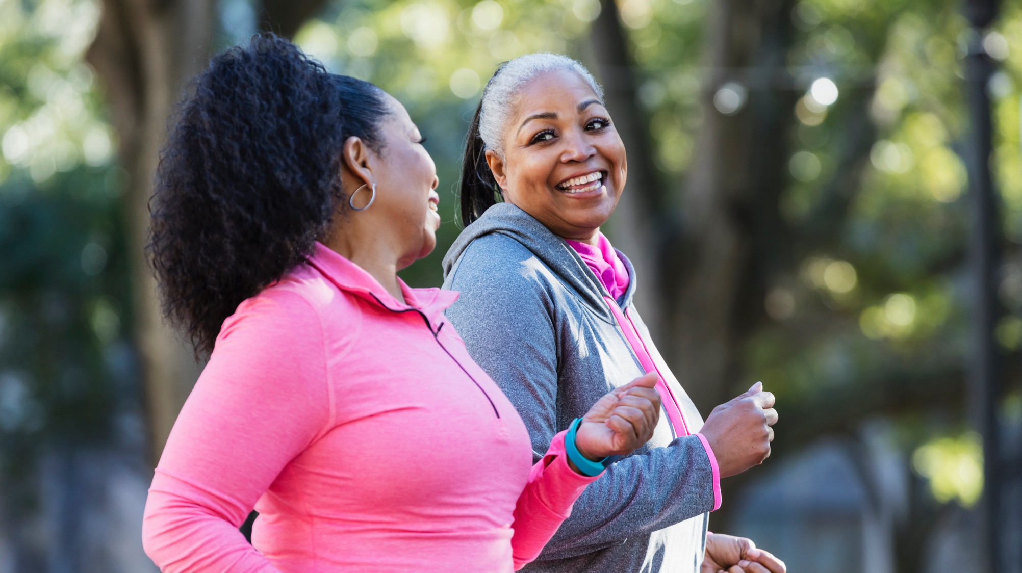
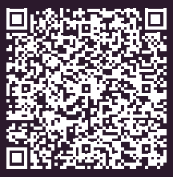
Inclusive Language Guide
ActiveLincolnshire.com/Knowledge-hub/Equality & Inclusion

Slide 11
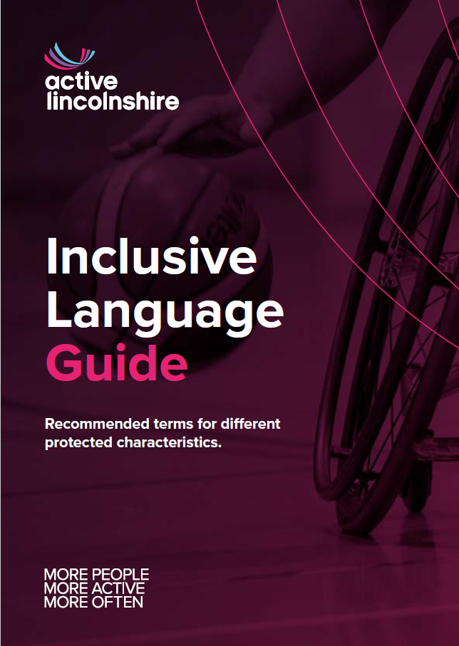
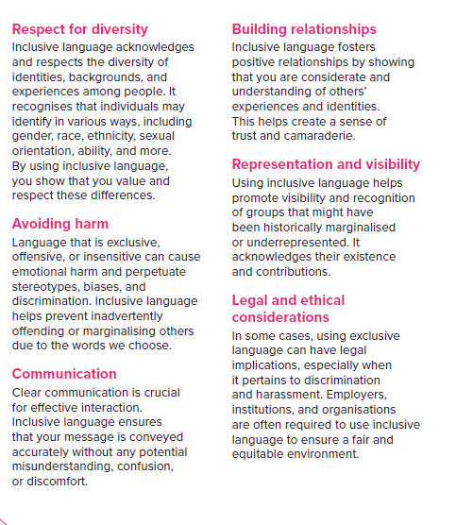
Why is inclusive language important?

Slide 12
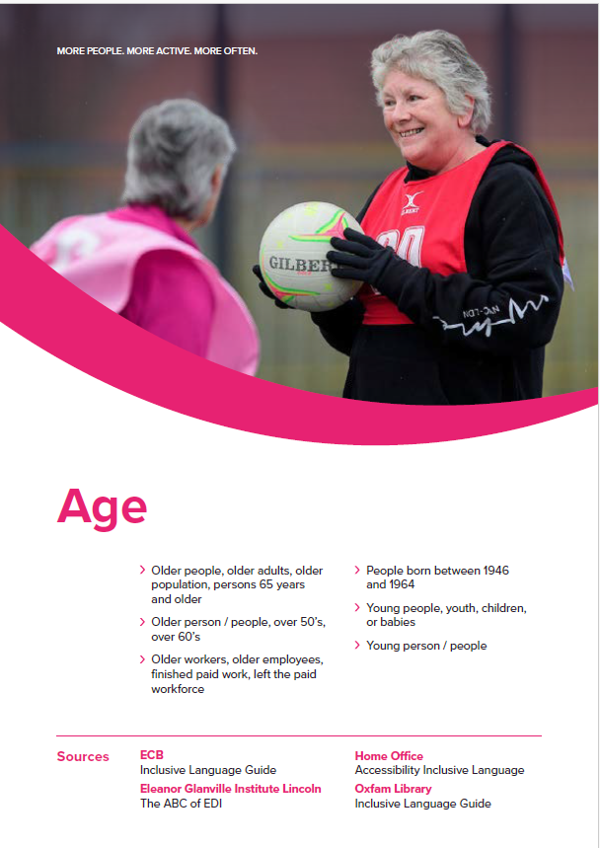
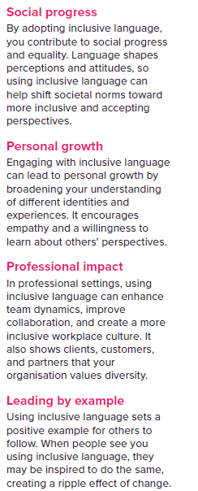
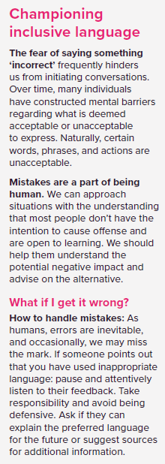

Slide 13
What is Inclusive Language?
Language that respects and includes all individuals.
Essential in making sport and physical activity accessible for everyone.
Why it Matters
Inclusive language increases participation.
Helps create a safe, respectful, and welcoming environment.
General Principles
Use people-first language (e.g., 'person with a disability').
Avoid stereotypes or assumptions.
Use accurate, respectful terminology.
Best Practice
Ask individuals what terms they prefer.
Be open to learning and correction.
Use gender-neutral terms where possible.
Language to Avoid & Alternatives
Avoid outdated or offensive terms.
Use respectful alternatives (e.g., 'wheelchair user' instead of 'confined to a wheelchair').
Specific Considerations
Disability: Use inclusive, non-stigmatising language.
Age: Avoid generation ……
Race/Ethnicity: Respect identity and terminology preferences.
Gender/Sexual Orientation: Use inclusive, affirming language.
Using the Guide in Practice
Apply inclusive language in communications, campaigns, and events.
Review materials for inclusive language regularly.
Inclusive language fosters respect and belonging.

Slide 14
We want to share resources and make this guide accessible to partners and their network. If you’re interested in adding your logo to this page.
Email Communications@ActiveLincolnshire.com we ask in return that you notify us of any language changes so that we can get it up to date.
ActiveLincolnshire.com

Slide 15
Tips
Accreditations
Branding guidelines (use the “Check Accessibility” in Word, Excel, PowerPoint, etc)
EDI policy
Lived experience
Marketing
Network
Staff survey – who, experience and knowledge

Slide 16
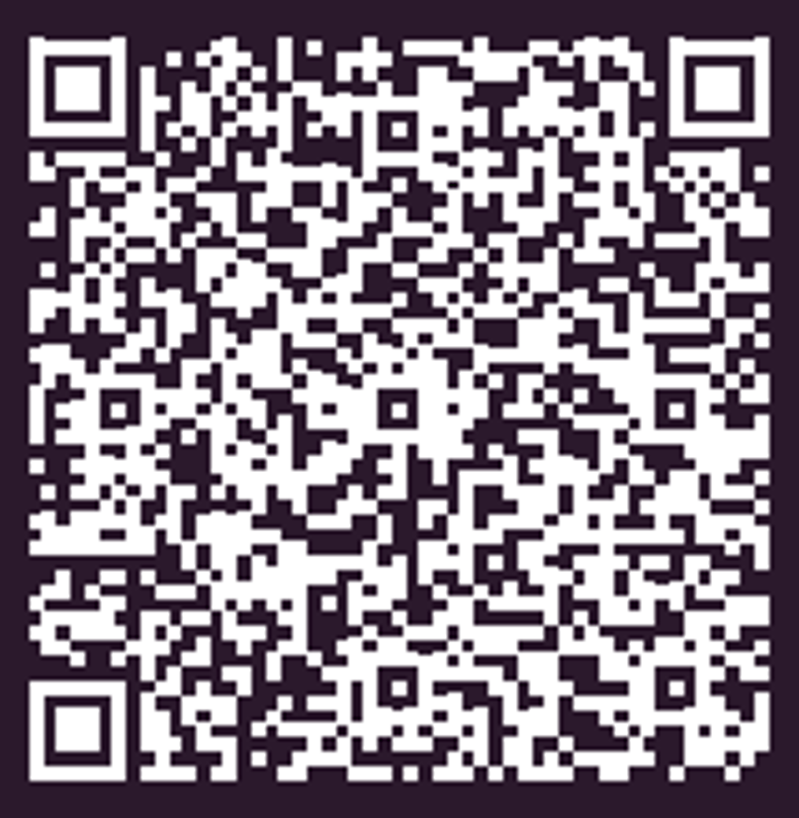
Further Resources
Visit activelincolnshire.com for the full Inclusive Language Guide.
Explore additional training and support on inclusive practice.
Coming soon a Safeguarding/welfare guide
Inclusive meetings guide.
Ian.Brown@ActiveLincolnshire.com
Ian Brown (he/him/his) Find out more about why I include my pronouns here
Equality, Diversity & Inclusion Manager
T: 01522 391 832 M: 07903 266 224
Active Lincolnshire, Newland House, The Point, Weaver Road, Lincoln, LN6 3QN
Web: ActiveLincolnshire.com
Find & list activities: LetsMoveLincolnshire.com
Safeguarding enquiries and policy: ActiveLincolnshire.com/Safeguarding
This communication has been written by a dyslexic person. If you have any issues or trouble understanding any of the sentences
or words, please do not hesitate to reach out for further clarification.

Slide 17
Moving to Inclusion

