Slide 1
Centre for Innovation in Fatherhood and Family Research University of Lincoln

Slide 2
Our work
Transforming the Following Young Fathers Further Fellowship study into a Centre (established 2023)
An applied social sciences study promoting father-inclusion and inclusive family support in practice and policy, 2020-24
Centre funding structure: supported by FLF+3 grant until 2027.
Focused on father-inclusion initially with potential to expand and respond to wider national trends relevant to diverse families.
Building networks and conversations locally and nationally designed to promote father-inclusion.

Slide 3
What we offer
Research, evaluations and analysis
Attracting funding from traditional and philanthropic funders,
Partnering on bids,
Responding to national strategic priorities through research and evaluations,
Informing policy strategies and initiatives through expert advice.
Service design and co-creation
Co-creation of an effective model of practice called the Young Dads Collective,
Ensuring service effectiveness through a ‘what works’ approach: documenting and informing on processes and outcomes,
Service reviews, analysis, design and development,
Training, workshops and continuing professional development
Masters in Inclusive Family Support
Provision of father-inclusive training and CPD
Multi-agency professionals using our evidence-based research for impact
Research-led interdisciplinary teaching and access pathways (e.g. FutureLearn)

Slide 4
Who this is relevant to?
Public health and social care services: Including ICBs, midwives, health visitors, and Family Nurse Partnerships,
Family Support Services – including Early help, early intervention, family charities and fathers’ groups (without a target age group),
Education and skills organisations: including Early Years Educators, teachers, and educational psychologists,
Local Authority Leaders and councillors,
Third sector organisations e.g. Dads groups/support, young people's support and men’s support services not relating to parenthood. (including youth services, dads groups, mental health, family support),
Child Protection and Family Welfare services,
Mental Health services: Therapists and perinatal mental health, Family Hubs
Criminal Justice – including youth workers, youth justice, preventative support services such as drug and alcohol support, police and Domestic Abuse Help, homelessness, and mental health interventions

Slide 5
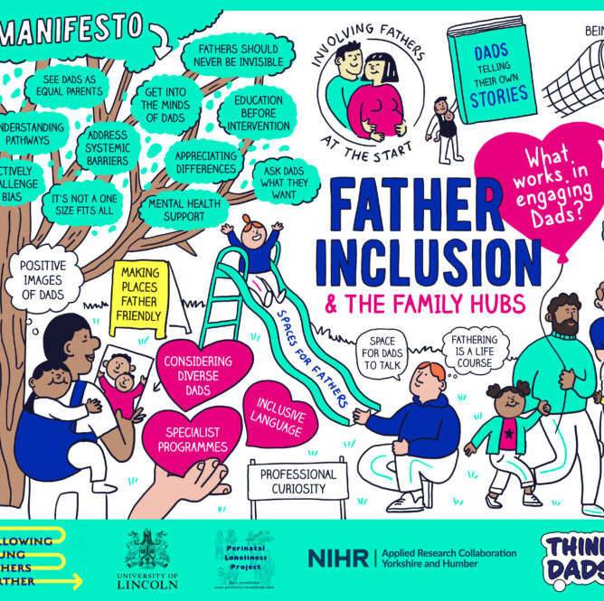
How can we work with LVET members?
Access our findings and resources to support with father-inclusion in your organisation
Identifying father-inclusive champions in different sectors
Research, consultancy and evaluation on projects
Support in establishing father support groups and services within Lincolnshire
Building a father-inclusion strategy for Lincolnshire

Slide 6
The Father-Inclusion Hub
Launched January 2025.
Repository for father-inclusive resources.
A growing archive of “what works”.
Already housing 64 practical resources from 15 leading organisations and growing!
Open access.
Invitation to submit resources, contact fyffteam@lincoln.ac.uk
https://fatherinclusion.org/

Slide 7
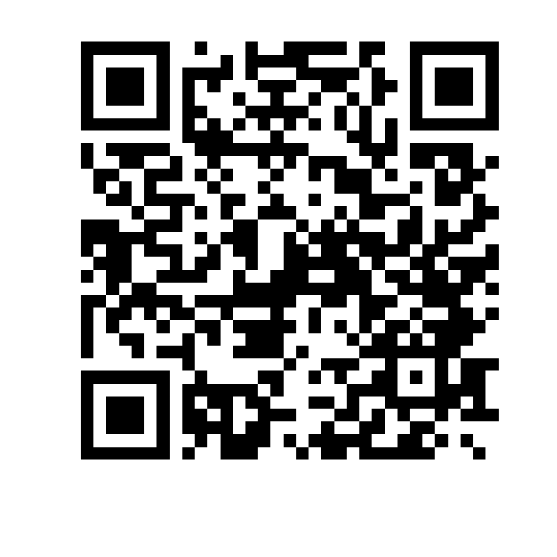
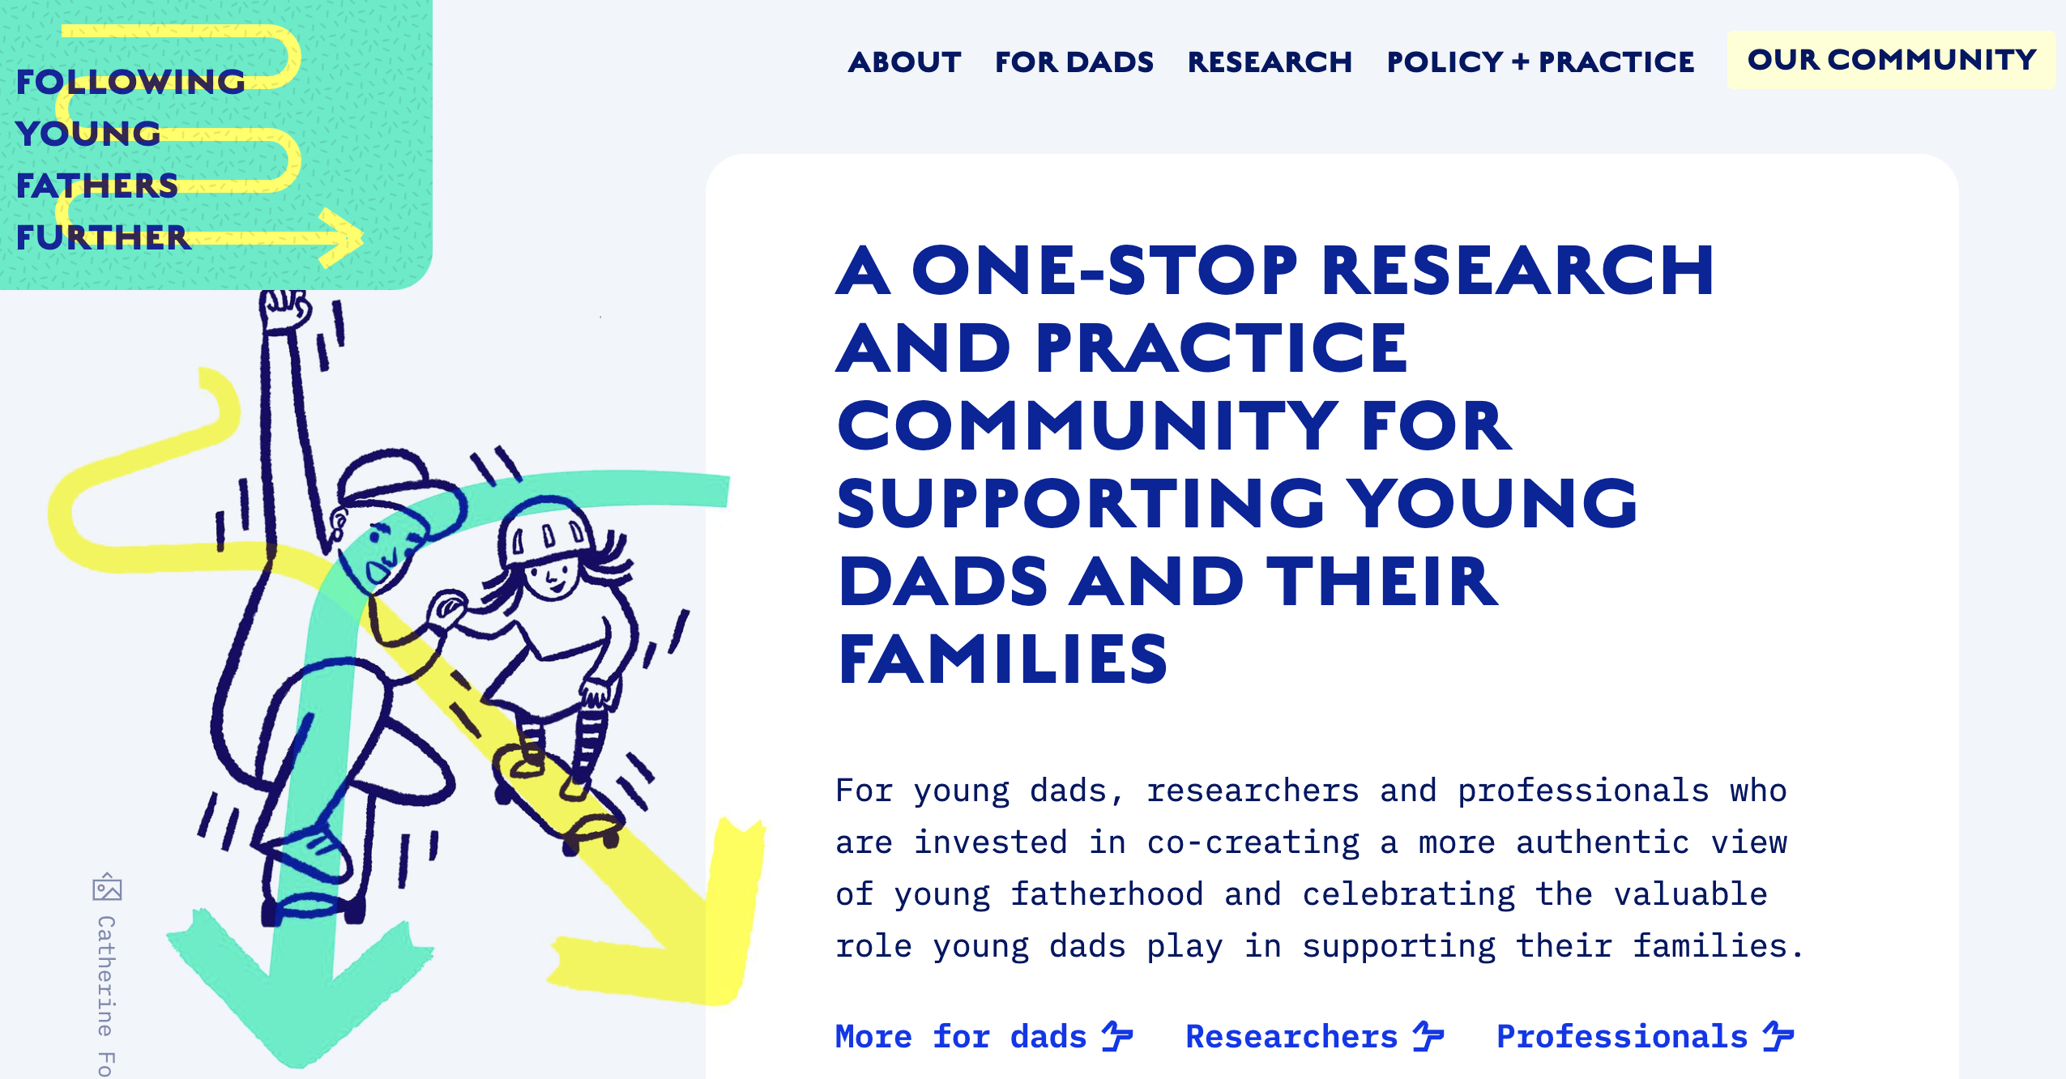
Stay in touch
Email us: fyffteam@lincoln.ac.uk
Following Young Fathers Further website: https://followingyoungfathersfurther.org/
Centre for Innovation in Fatherhood and Family Research: https://www.lincoln.ac.uk/socialsciences/research/innovationinfatherhoodandfamilyresearch/
Join our mailing list

