Slide 1
Shropshire, Telford & Wrekin Cancer Champions
Miranda Ashwell, LiveLife Lead, Lingen Davies Cancer Fund
Alex Mace, Project Manager, Shropshire, Telford & Wrekin

Slide 2





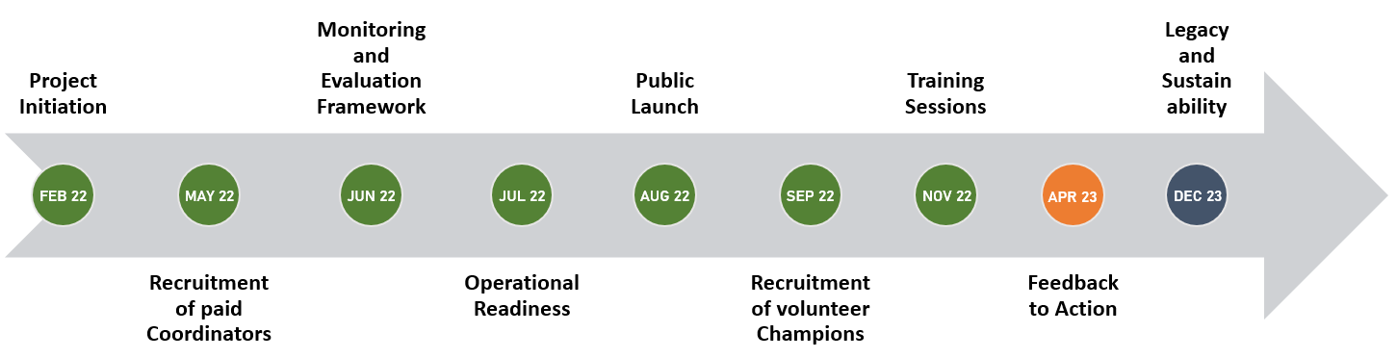
Core20PLUS5 Connectors (STW Cancer Champions)
Delivered in Partnership
Aim 1
Positively contribute to our achievement of the goal of 75% of cases diagnosed at stages 1 or 2 by 2028.
Aim 2
Understand the perspective of individuals who may not be accessing what is universally on offer, and why this might be.
Aim 3
Understand and increase screening uptake in those communities where this is low and awareness of symptoms that should prompt presentation to healthcare providers.
2
300
Champion Coordinators
Cancer Champions
Notes:
In support of the Core20PLUS5 Approach, NHS England developed the Core20PLUS Connectors Programme.
The programme aims to develop networks of people within our community, known as Connectors, who are people from communities who often do not feel supported by existing services. Connectors can have a huge impact on the actions we take to improve health and reduce healthcare inequalities.
Shropshire, Telford & Wrekin were successful in our bid to be one of the first sites to pilot the programme and we chose to focus on supporting early cancer diagnosis. The project would build on current programmes of work, such as local outreach teams and social prescribing networks, to develop our integrated working across programmes all with the similar aim of contributing to the % of cancers diagnosed at earlier stages. This was also an opportunity to build relationships with our community and understand what barriers there might be for people in accessing screening.
The project is delivered in partnership between local NHS, Council’s and our delivery partners, Lingen Davies Cancer Fund and Qube Oswestry Community Action. We have two paid Champion Coordinators who promote, network and engage with local communities and organisations and recruit and offer ongoing support to our Champions.
The project commenced in February 2022, publicly launched in August 2022 and has been training Cancer Champions since November 2022. Our original target was to have 50 Cancer Champions across the county but to date we have over 300.

Slide 3

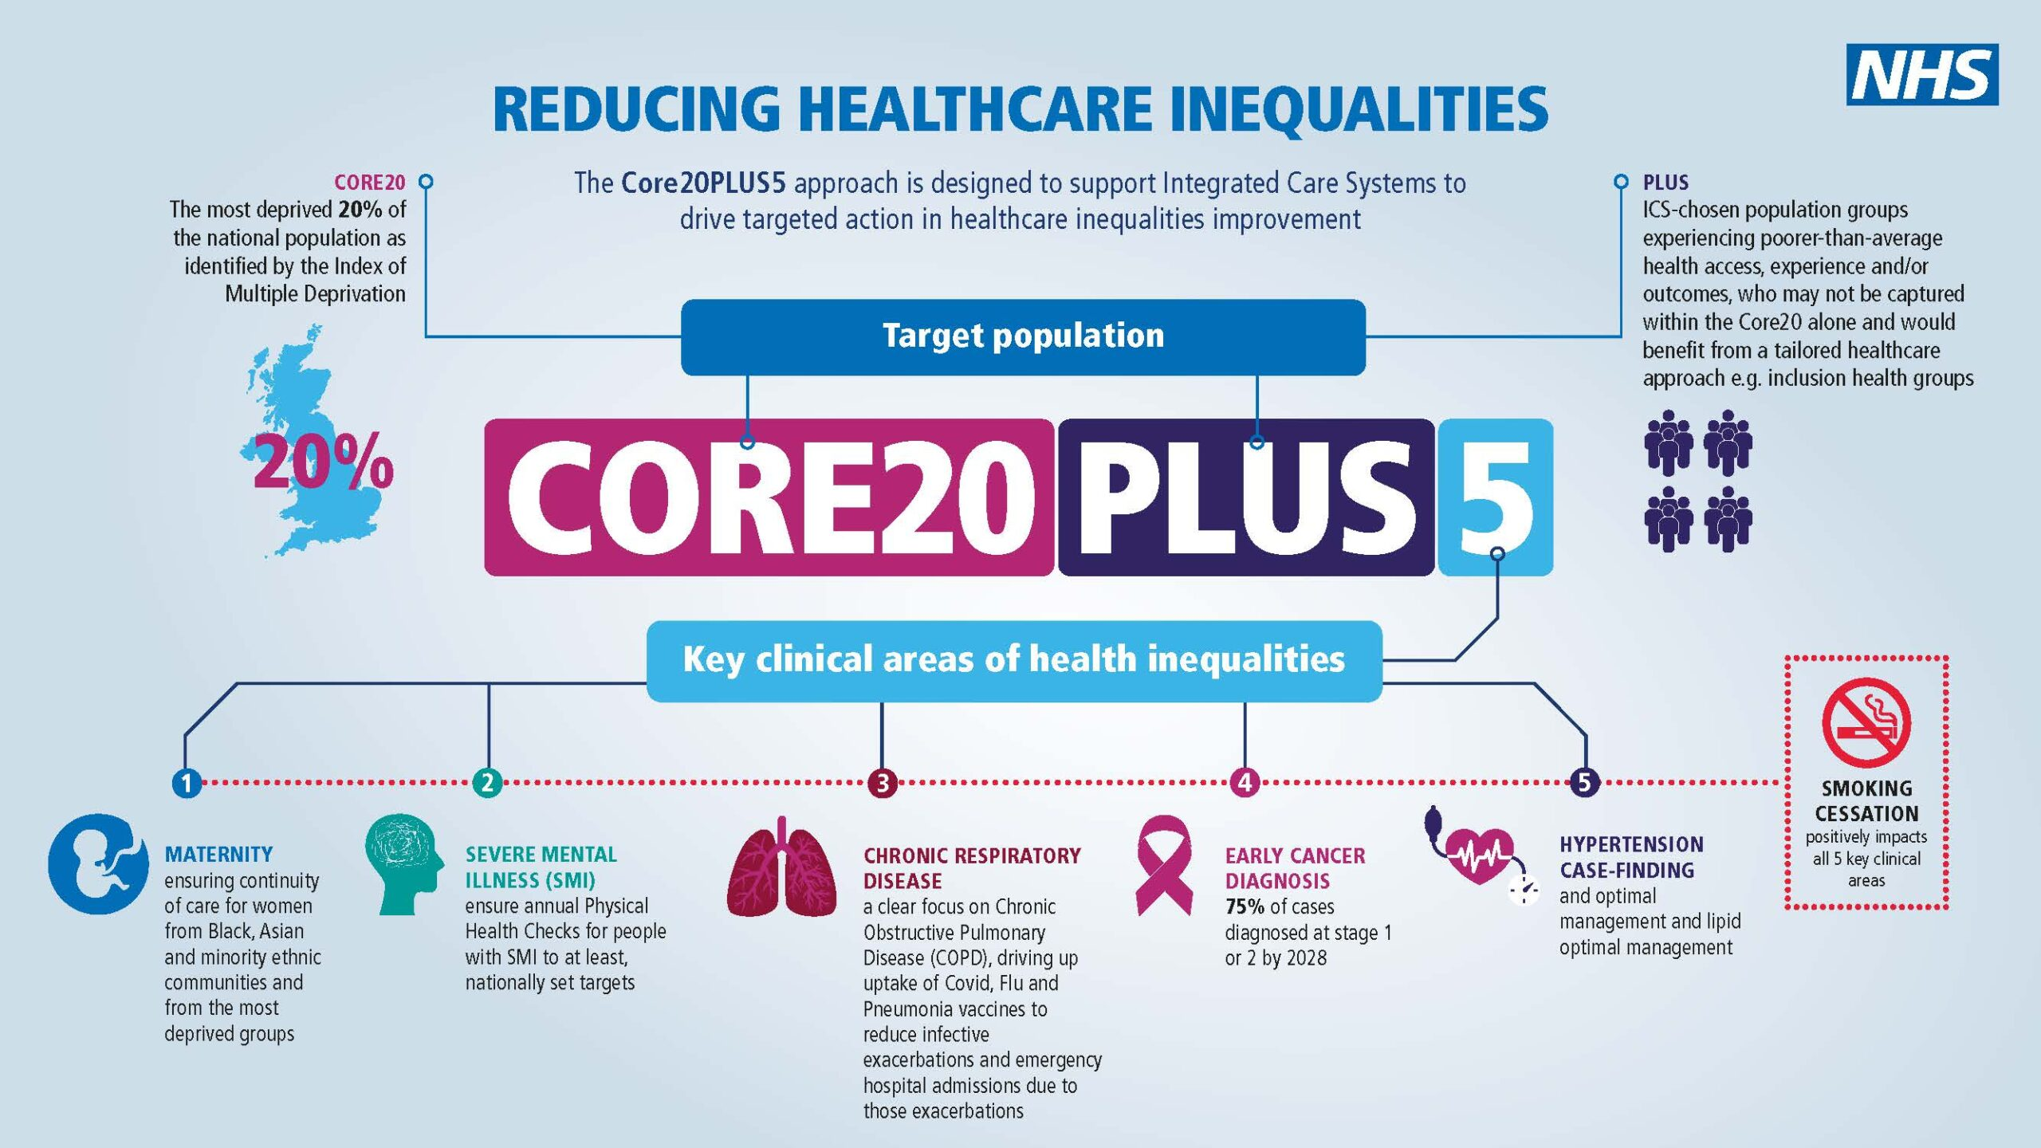
Core20PLUS5: A National Approach to Reducing Healthcare Inequalities
The 20% most deprived areas across the UK.
Population groups who experience poorer than average health access, experience and outcomes.
5 key clinical areas where we can make a difference.
Notes:
The Core20PLUS5 approach was designed by NHS England. It identifies target groups of the population where the NHS can make a real difference to health inequalities through targeted intervention.
Core20 refers to the 20% most deprived areas across the country.
PLUS refers to additional locally identified groups or communities that might experience poorer healthcare access, experiences or health outcomes, such as those who are homeless, people people with learning disabilities, refugees or those living in rural areas.
5 stands for the 5 key clinical areas where evidence suggests we could make considerable improvements in health inequalities.
Find out more:
https://www.england.nhs.uk/about/equality/equality-hub/national-healthcare-inequalities-improvement-programme/core20plus5/

Slide 4

Background and Aims
Shropshire, Telford & Wrekin (STW) Integrated Care System (ICS) were successful as a wave 1 implementer site for the Core20PLUS Connectors Programme; an initiative which develops and supports community-based roles known as ‘Connectors’ to impact on the goals of the Core20PLUS5.
The Connector approach recognises that people and communities often know what they need and the NHS needs to hear directly from them to reduce barriers and build trust.
Aim 1
Positively contribute to our achievement of the goal of 75% of cases diagnosed at stages 1 or 2 by 2028.
Aim 2
Understand the perspective of individuals who may not be accessing what is universally on offer, and why this might be.
Aim 3
Understand and increase screening uptake in those communities where this is low and raise awareness of symptoms that should prompt presentation to healthcare providers.

Slide 5

Our Partnership Approach
Empowered to impact change through knowledge and awareness and spreading the word through family & friends.
Sharing their experience and suggestions.
Cancer Champions
Shropshire Council
Qube
Specialist knowledge and strong relationships with communities, built on trust.
Asset-Based Community Development, utilising VCSE infrastructure and offering flexibility and support.
NHS
STW
T&W Council
Lingen Davies
Connecting with community organisations
Guiding targeted intervention through public health knowledge and intelligence.
Friends, families and neighbours
Central coordination, facilitation and strategic support.
Connecting into local healthcare organisations and championing the case for change.

Slide 6


What is a Cancer Champion?
A person with interest or lived experience and commitment.
Everyday conversations with family, friends and colleagues:
Understand experience and perceptions of their community (cancer, cancer screening and prevention).
Encourage local people to take up screening/report possible symptoms.
Understand experience and perceptions of their community (cancer, cancer screening and prevention).
Feedback experiences, understanding and insight to generate better.
Trained and supported: Understanding of cancer screening, prevention and symptoms.

Slide 7

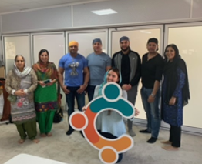
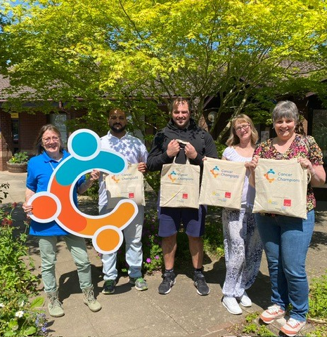
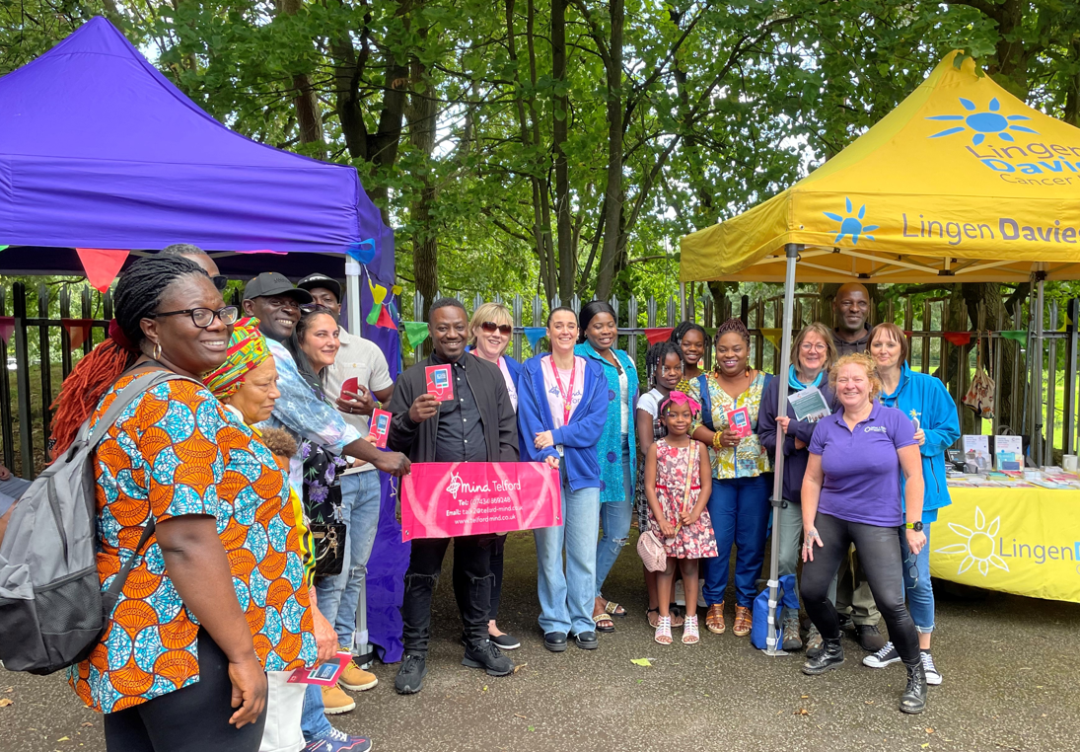
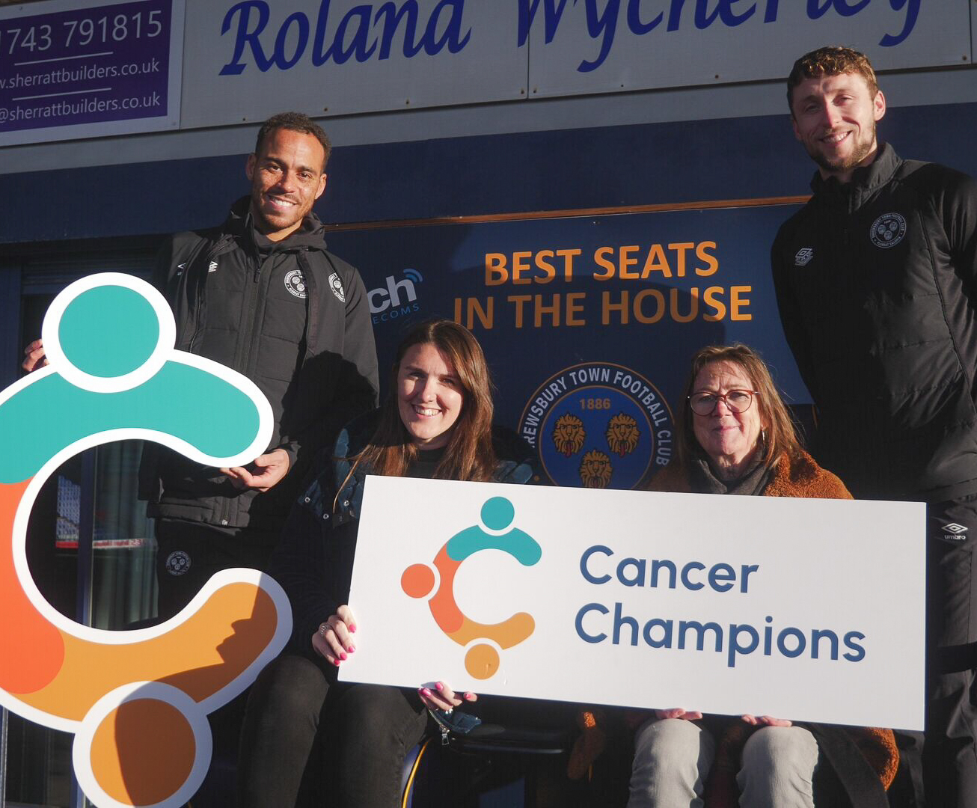
Engaging through Partnerships
Asset-Based Community Development (ABCD)
Connected with organisations and trusted professionals that worked with people we wanted to reach
Recruited via our Cancer Champion website submission form
Trained Cancer Champions spread the word and recruit friends, contacts and colleagues
Cancer Champion flyer
Wellbeing Champions in local businesses
Community events
84 Organisations
Engaged
150+ Cancer Champions

Slide 8
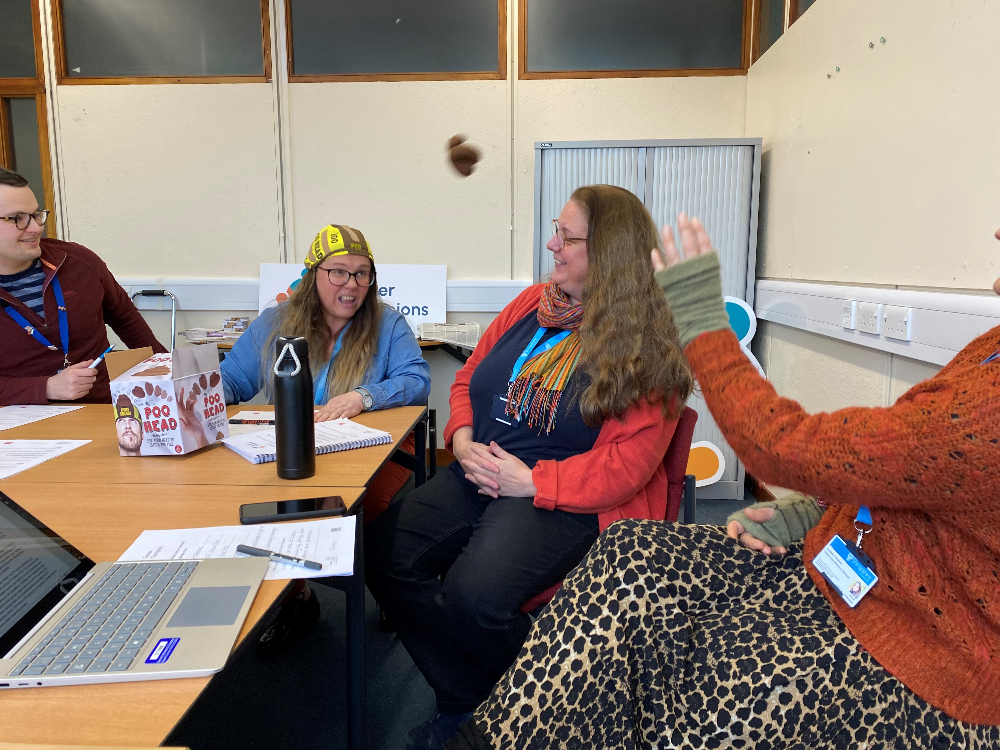
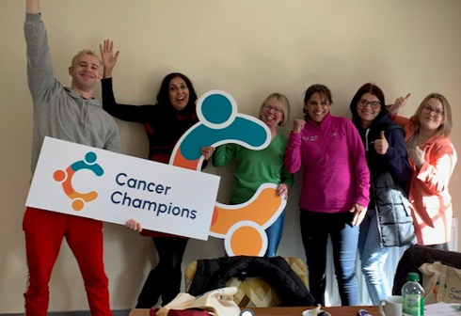
Very interesting & enjoyable session with Miranda and her team. Learned a lot and picked up some useful conversational tips.
Training
Flexible model
Positive content:
The role of a Cancer Champion
Understanding Cancer
Importance of early diagnosis & screening
Effective conversations
Small and informal groups
Make it enjoyable - use humour to break stigma (poo games, layman’s language)
Resource packs and badges – tools to raise the topic
Confidence scale
Very enlightening. I look forward to spreading the word to others
Engaging slides & diagrams, easy to follow & relate to. Really enjoyed the informal atmosphere so it was easier to actively discuss, thanks!
Very detailed but accessible, exciting to hear about the research and support out there

Slide 9


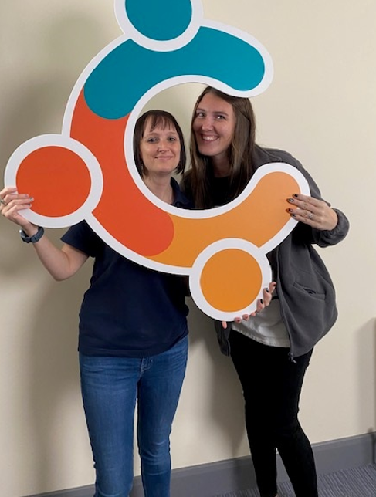
Our Partnership with our Cancer Champions
Staying connected:
Monthly Newsletter
Coffee catch up mornings
WhatsApp group
121’s (face to face or online)
Additional training
Feedback and co-development:
Cervical Screening Survey
Podcast with Dr Hilary Jones
Multi-lingual videos (next slide)

Slide 10
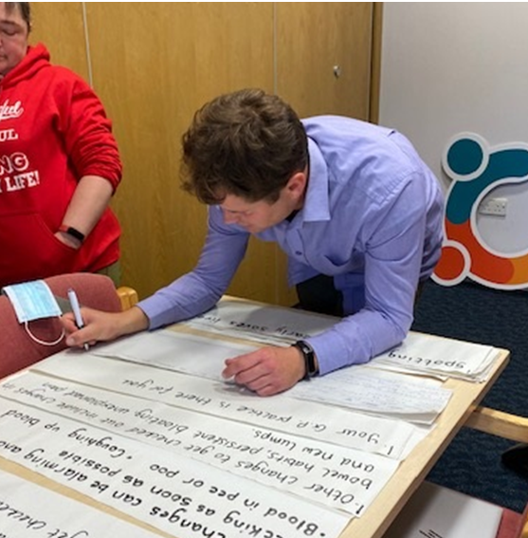
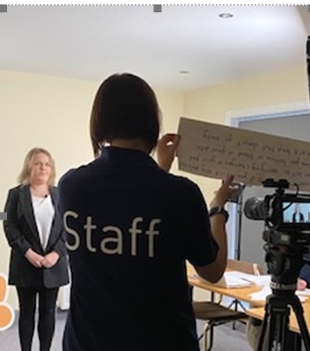
Co-development of Multi-lingual Videos
Recruitment via community networking & focused locals comms.
Languages: Punjabi, Mandarin, Bulgarian, Polish and Ukrainian, with sub-titles.
Half day workshops – to translate and film.
Finished product – breast, bowel, cervical screening, signs and symptoms .
Volunteers became our first Cancer Champions.

Slide 11

What we’ve learnt
The importance of the Asset Based Community Development (ABCD) approach – empowering our champions so they are part of the development and growth of the project.
The pace of recruitment – guided by our Champions, not our Coordinators.
Trust
Patience
Being flexible with recruitment to allow Champions to engage at their own pace.
The value of trust and building solid relationships with our Champions.
Make the role theirs, not ours, as it fits their lives or role in the community or workplace. This ensures:
Champions have ownership of their role.
The process is less daunting and more feasible in both workplace and community settings.
It reduces Champions’ concerns about not meeting expectations or being able to fully commit to the project.
Flexibility

Slide 12
Insights and Impact
How
Where
What
Project Group
NHS England
Key themes:
Project Group
Language/literacy issues
Understanding of screening
Fear and denial
Staff attitudes/communication
Negative experiences
Myths & misconceptions
Cultural attitudes to health/body
National Cancer Alliance
Delivery Partners
Delivery Partners
Prevention and Health Inequalities Board
Core Connectors
Core Connectors
Place-based Boards
Local Communities
Cancer Strategy Board
Local Communities
Recommendations
1:1 conversations
Group meetings
Community events/talks
Training sessions
Cancer Champions conversations with communities/groups (WhatsApp, monthly socials, email, support meetings).
Conversations with members of the public.
Early Cancer Diagnosis Group
Healthy Lives Steering Group
Local Webinars
ACTION
Direct Conversations

Slide 13
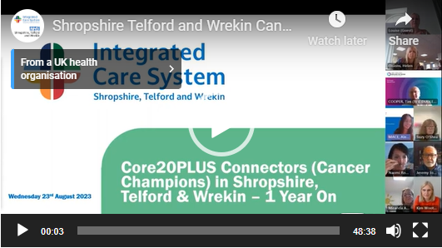
What would help?
Increased use of accessible information
Multi-lingual resources and easy-read
Website translation facilities
Watch our full insights webinar here.
Improved communication
About the value and frequency of screening and why it differs to other health systems.
Stories of survivorship
Consistent approaches for Prostate Cancer
Promotion of the Prostate Cancer UK Risk Checker
Consistent frequency and types of testing
Proactive approaches and reassurance
Acknowledging embarrassment and fear
Reassurance about seeking help despite the outcome
Proactively checking for concerns
Notes:
A dedicated webinar was held in August 2023 to share detailed insights and suggestions for what would help to reduce barriers to accessing screening. This can be accessed here:
https://www.shropshiretelfordandwrekin.nhs.uk/successful-bid-to-be-a-wave-one-implementer-for-core20plus-connectors-programme/
Some overarching suggestions have been included on the slide.
Increased use of accessible information
Promotion of easy-read and multi-lingual resources (available at www.cancerchampions.co.uk)
Building translation facilities into NHS and GP websites.
Improved communication
Improved communication about the value of screening and, specifically for newly arriving populations, information about screening frequency and the NHS being not-for-profit but based on evidence and need.
Share more positive human stories about individual lives saved through early diagnosis due to screening and improved communication to portray a positive picture of cancer survivorship.
Consistent approaches
A consistent primary care approach to how men at high risk are checked for prostate cancer, the type of testing, and frequency of high-risk men testing. Promotion of PCUK Risk Checker and greater communication to promote understanding of PSA testing.
Proactive approaches and reassurance
Listening to and acknowledging people’s embarrassment/fear and asking to understand.
Reassurance that seeking help for concerns is a valid use of NHS time.
Pro-active and consistent approach to asking about concerns such as use of the Jo’s Trust Concerns Checklist.
The Project Team has been working closely with colleagues across the system to inform local actions, strategies and resources based on the insights we have gathered. This includes informing the developing Cancer Strategy.

Slide 14
More Information
More Information about Core Connectors and STW Cancer Champions
Core20PLUS Connectors
Shropshire, Telford & Wrekin Cancer Champions
August 2022 Webinar – Introduction
Core20PLUS Connectors Programme Interim Report July 2023
Useful resources
Multi-lingual Videos – Cancer Awareness and Screening
‘TeachBack’ Films for Health Literacy
Articles
County Cancer Champions Launch
County Cancer Champions launched to address rising numbers
Oswestry charity Qube joins drive to get people screened for cancer
Shrewsbury Town players are now Level One Cancer Champions
Multi-lingual Approach to Fight Cancer
Notes:
www.cancerchampions.co.uk

Slide 15
Thank you
If you would like to find out more, please visit www.cancerchampions.co.uk
or contact:
miranda.ashwell@lingendavies.co.uk
Alexandra.mace@nhs.net

