Slide 1
Cancer Health Inequalities VCFSE Grant Collaboration Day
Thursday 14th August 2025

Slide 2
Outline
This fund offers grants of:
Up to £5,000 for individual organisations
Up to £15,000 for collaborations with two or more organisations
Funding supports projects that remove barriers to access, improve experiences, or enhance outcomes at any stage of the cancer pathway

Slide 3
Target Cohorts
Our objective is to enhance access to diagnostics and treatment, as well as to improve the survivorship experience, within these key cohorts -
People with Learning Disabilities
Older people within areas of deprivation
IMD 1&2

Slide 4
Cancer and Health Inequalities
Lincolnshire has a population of 770,000 of whom currently over 37,000 are living with cancer and this is expected to rise to 45,400 by 2030
Nationally, more than 30,000 cases of cancer are attributable to socioeconomic deprivation and survival is worse for the most deprived groups
49% of people living in the 20% most deprived are diagnosed with cancer at an early stage (stage 1 or 2), compared to 58% of people from the least deprived 20%
31.2% of eligible women with a learning disability received cervical smear tests, in contrast to 73.2% of women with no learning disability
In Lincolnshire, the gap in life expectancy between the least deprived and most deprived is 9 years for men and 7 years for women

Slide 5
NHS – 3 Key Shifts
1. Hospital to community
2. Analogue to digital
3. Sickness to Prevention

Slide 6
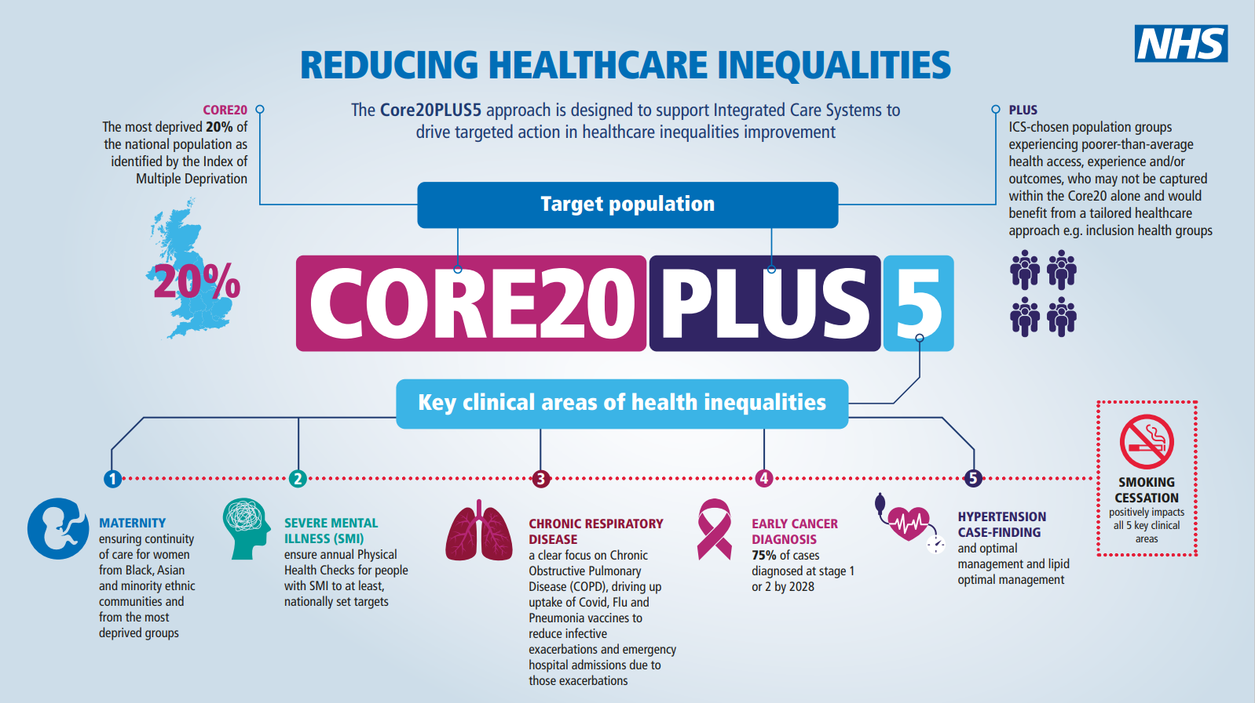
NHS England » Core20PLUS5 (adults) – an approach to reducing healthcare inequalities
Notes:
Angela

Slide 7
NHS Cancer Targets
The NHS Cancer Programme has developed a Faster Diagnosis Framework, which sets out the strategic approach to speed up cancer diagnosis and improve patient experience.
28 days from referral to finding out if you have cancer or not
31 days from decision to treat to treatment (new and subsequent treatments)
62 days from point of referral to treatment starting

Slide 8
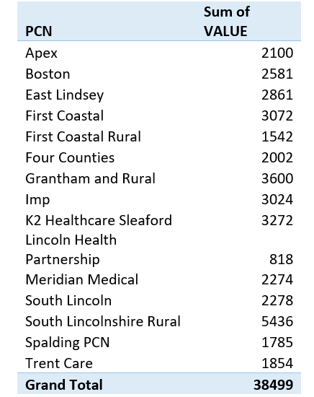
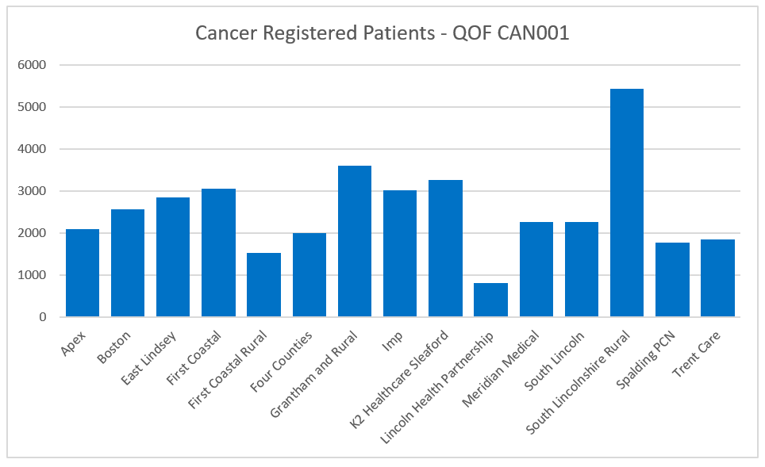
PCN and Cancer diagnoses

Slide 9
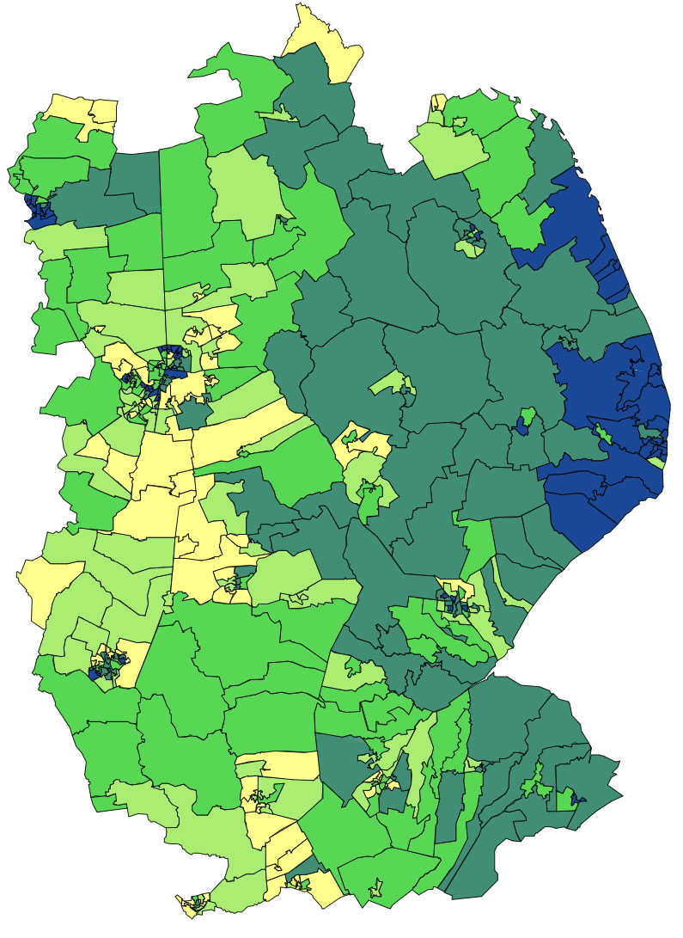
Deprivation in Lincolnshire
 | Most Deprived
 | Least Deprived

Slide 10
Learning Disabilities
In 2017-2022 there was 22.665 deaths in the UK of people with learning disabilities
42% of these were avoidable
Average age of death is 62.9 years in comparison with 81.8 for men and 85.5 for women in the general population
One of the top 3 causes of death is Cancer
People from ethnic minority backgrounds with a learning disability die younger than the white ethnic population

Slide 11
Access to Diagnostics
We want to ensure timely access to diagnostic tests for suspected cancer so people can receive a faster diagnosis, begin treatment sooner, and improve their chances of recovery.
Barriers faced could include;
Distance
Lack of - or cost of transport
Anxiety/Mental Health
Work commitments
Child or pet care
Immobility or frailty
Language or cultural differences

Slide 12
Access to Cancer Treatment
The challenges our target cohorts face to accessing cancer treatment could include those on the previous slide, plus -
Caring responsibilities
Domestic abuse
Immobility
Other illness

Slide 13
Survivorship
How can we create equity for better survivorship and living well when facing a cancer diagnosis?
Examples might include:
Prehabilitation
Financial support
Community support groups
Access to mental health support
Personalised information and advice
Holistic needs

Slide 14
Thank you

