Slide 1
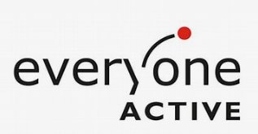

'Fit For Surgery' Model
Health – EA Partnership
EA Run referral scheme
For those on NHS waitlist for hip and knee surgery
12-week course
Additional classes such as Escape Pain, Chair Based exercises and Good Boost
Target participant numbers agreed between EA, client and Health
GP referral membership as an exit route following surgery

Slide 2
Fit For Surgery – Plan, Deliver, and Evaluate
Helping to reduce pressure on NHS Waiting Lists and support pre-surgical physical therapy.
Referral by health care professional or self-referral to EA
Pathways and funding agreed
EA referral pathway + paid self-referral
Staffing, facility hire, marketing and tea/coffee included
Quarterly check-ins and progress reports between PCN, Client and EA
Participants evidence improvement in condition and feedback on the pathway
Potential use of, IPAQ, MSK Questionnaire, HOOS & KOOS, and Warwick and Edinburgh survey and EQ5D-5L

Slide 3
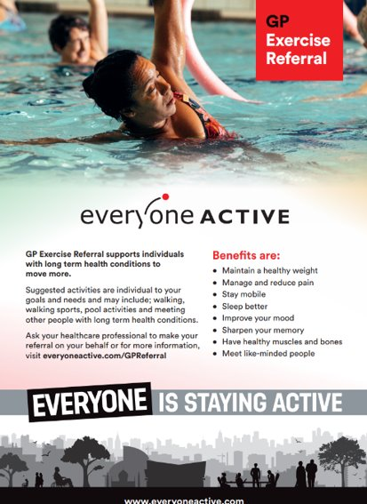
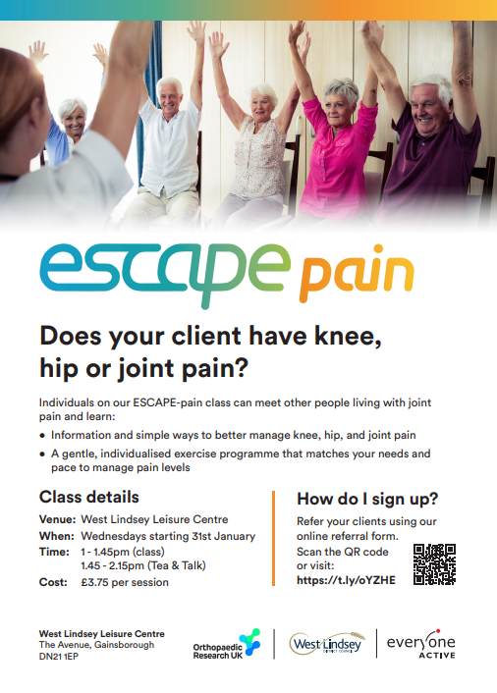
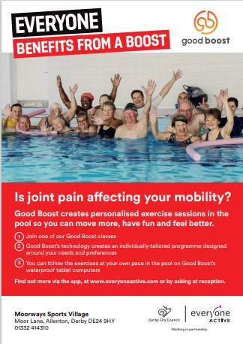
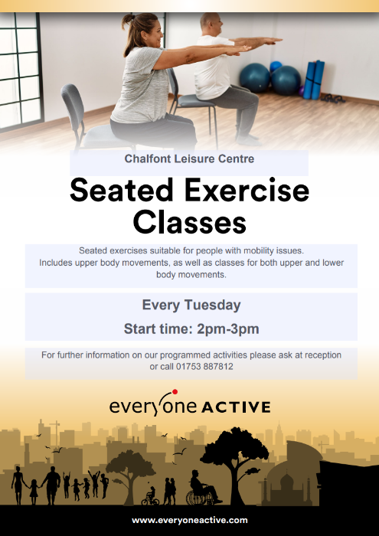
Our Services
Our services
To facilitate a wider MSK programme from the leisure facilities we can offer a wide variety of activities to help sustain physical activity levels during and beyond the 12-week intervention.

Slide 4

Impact

